Slide 1
Tissue Viability
Pressure Ulcer Training
Warning: Graphic Content
Stacey Evans-Charles, Nkamba Sende, Mikyung Bailey

Slide 2
Session Focus
Aetiology and causes of pressure ulcers (PUs)
The impact of pressure ulcers for the patient and the NHS
Risk assessment and identifying individuals at risk of pressure ulcers
Waterlow score and aSSKINg
aSSKINg assessment
Categorisation of pressure ulcers
Differential diagnosis and Incontinence Associated Dermatitis
How you can prevent pressure ulcers from occurring or deteriorating
Stacey Evans-Charles, 28/01/2023

Slide 3
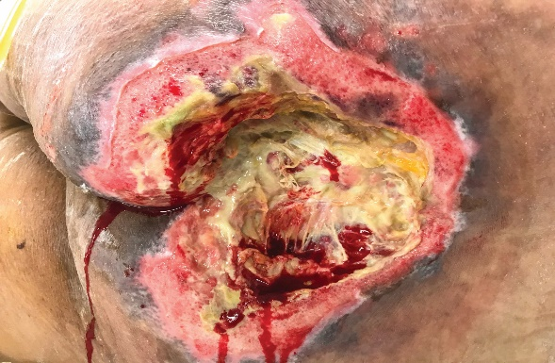
What Are Pressure Ulcers?
Bed Sores
Decubitus Ulcers
Pressure Sores
Pressure Injury
A pressure ulcer is localised damage to the skin and/or underlying tissue, usually over a bony prominence (or related to a medical device or other device), resulting from sustained pressure (including pressure associated with shear). The damage can be present as intact skin or an open ulcer and maybe painful.
The NPUAP/EPUAP 2014 system of categorising pressure ulcers should be used incorporating categories 1,2,3,4, Deep tissue injury (DTI), and Unstageable ulcers.
Stacey Evans-Charles, 28/01/2023

Slide 4
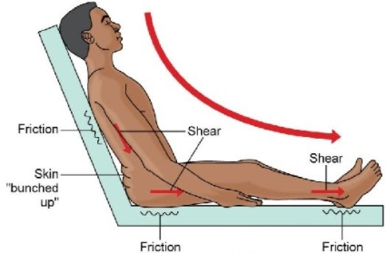
Shear
Shear stresses are thought to act alongside pressure to produce the damage and ischemia (death) of the skin and deeper tissues that results in pressure ulcers.
Shear injury will not be seen at the skin level because it happens beneath the skin..
Shear is a mechanical force, for example; pulling parts of the body in opposite directions.
Body weight
Tight bedding
Friction
Shear
Skin “bunched up”
Shear
Friction
Friction
Friction
Stacey Evans-Charles, 28/01/2023
Stacey Evans-Charles, 28/01/2023

Slide 5

Patients At Risk Of Shear
Those with a need to have head of bed elevated
Those who are difficult to reposition without sliding across surfaces
Those that slip/slide from a position they have been placed in
Those too weak to reposition independently without dragging themselves across surfaces
Those with skin exposed to high pressure over a bony prominence
Those with moist, wet or macerated skin
Stacey Evans-Charles, 28/01/2023

Slide 6
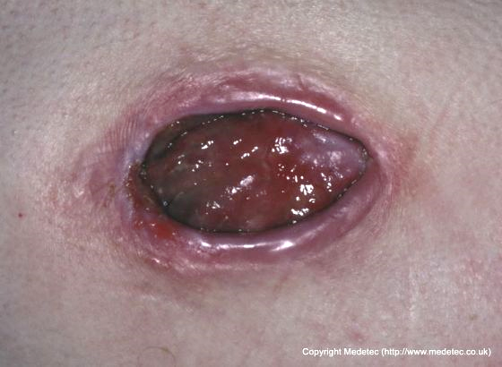
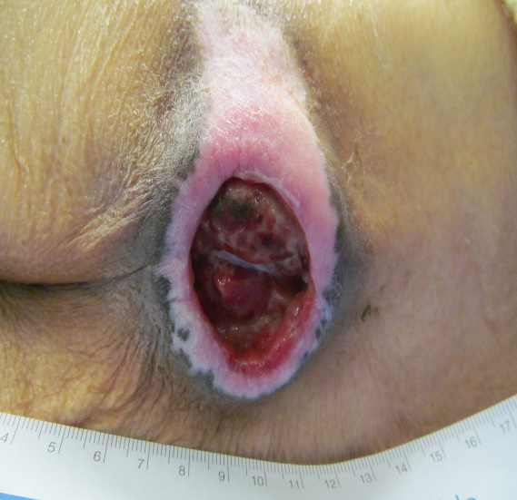
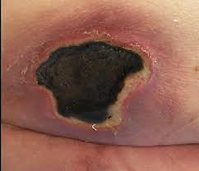
Causes of Pressure Ulcers
Caused when an area of skin and the tissues below are damaged as a result of being placed under pressure sufficient to impair their blood supply.
Stacey Evans-Charles, 28/01/2023

Slide 7
The Impact of
Pressure Ulcers
Stacey Evans-Charles, 28/01/2023

Slide 8



Prevalence of Pressure Ulcers
Prevalence remains high, with a recent audit suggesting a rate of 9.04% of patients across 36 hospital settings (Wounds UK, 2021).
10%
Treatment of PUs is costly, averaging £1,214 - £14,108, depending on severity and associated complications (Dealey, Posnett & Walker, 2012). Phillips et al (2016) indicate that the high cost is associated with the provision of care from health professionals, rather than wound care products.
Stacey Evans-Charles, 28/01/2023

Slide 9
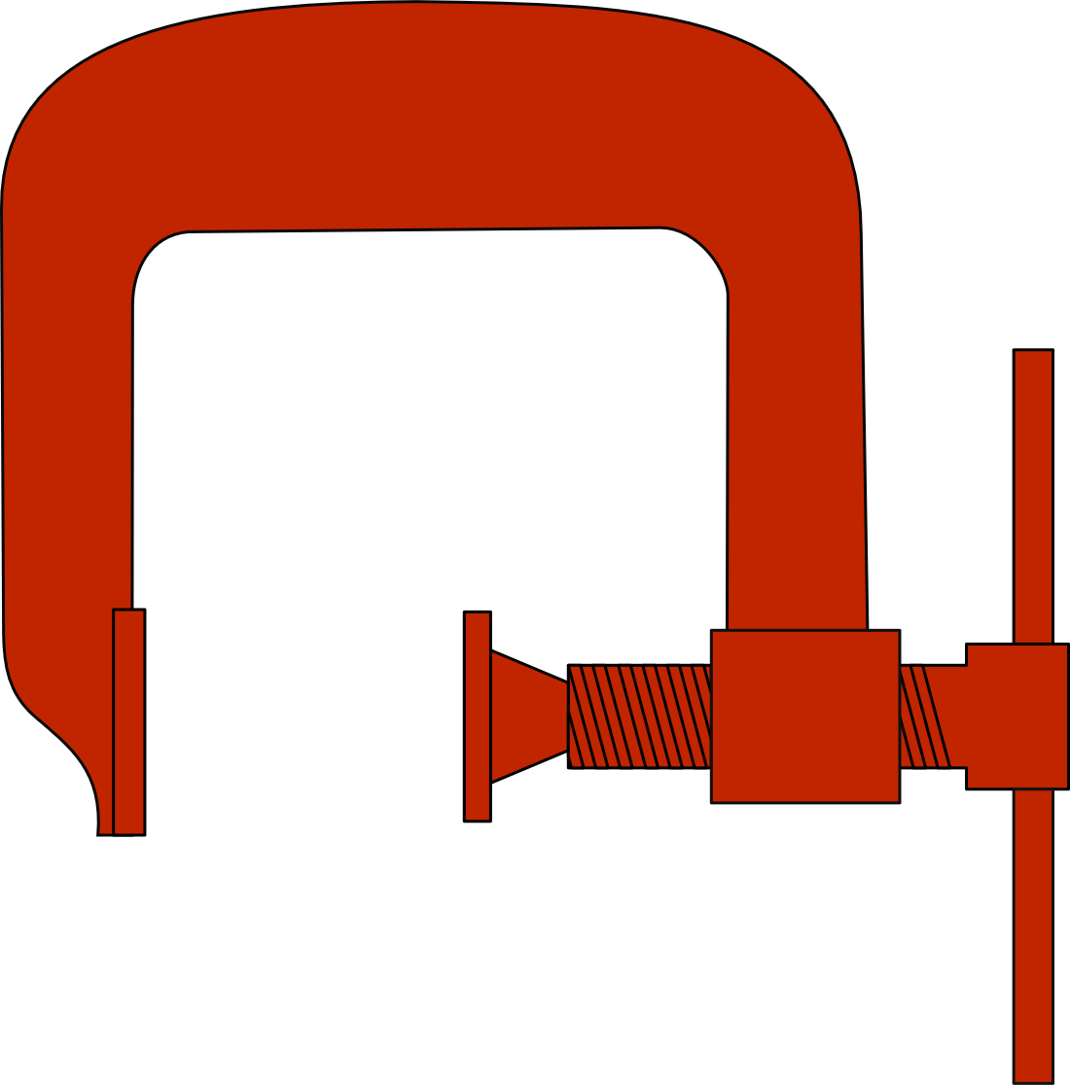

The Burden of Pressure Ulcers
The mean NHS cost of wound care over a 12 month period ranged from £1,400 for a category 1 ulcer to >£8,500 for other categories.
Guest et al, 2018.
Additionally, the cost of managing an unhealed ulcer was 2.5 times more than that of managing a healed ulcer.
The NHS cost of wound care in 2017/2018 was an estimated £8.3 billion.
Guest et al, 2020
£
Stacey Evans-Charles, 28/01/2023

Slide 10



The Impact of Pressure Ulcers…
On the patient?
On the NHS?
On your individual roles
Stacey Evans-Charles, 28/01/2023

Slide 11

Risk Assessment
Waterlow Score
Mobility
Incontinence
PMH
Social History
Psychological
Medication
Nutrition and Diet
!
Stacey Evans-Charles, 28/01/2023

Slide 12
Further Pressure Ulcer Risk Indicators
1
2
3
4
Skin
Previous PU
Fragile Skin
Surgery
Surface
Equipment
Spinal Injury
Sensory Loss
Keep Moving
Mobility
Fractured Hip
Vascular Disease
Palliative Patient
Incontinence
Faecal
Acute Illness/Sweating
Urine
Stacey Evans-Charles, 28/01/2023

Slide 13

Risk assessment is an essential component of clinical practice that aims to identify individuals who are susceptible in order that appropriate interventions to prevent pressure ulcer occurrence can be planned and implemented.
Implement and complete a risk assessment tool
Undertake a comprehensive SSKIN
Risk assess if the patient becomes acutely unwell, until clinically stable
Stacey Evans-Charles, 28/01/2023

Slide 14
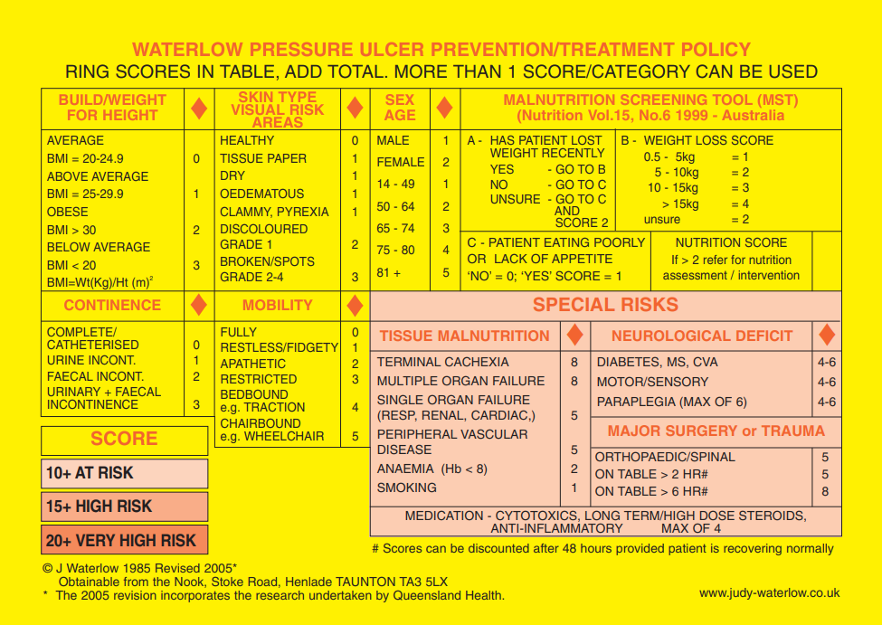
Waterlow Score Chart
Stacey Evans-Charles, 28/01/2023

Slide 15
Scenario 1
Mrs H is a 62 year old agoraphobic lady, her MUST score is 0, and her BMI is 24, she has no continence issues. She walks unaided and has healthy skin. She feels she has not lost weight as her clothes still fit. However 4 years ago she was diagnosed with pernicious anaemia and she has a B12 injection every 12 weeks.
What is her Waterlow score?
What equipment and referral requirements may she have?
Anything else to consider?
Stacey Evans-Charles, 28/01/2023

Slide 16
Scenario 2
Mr L, 52 year old man with multiple sclerosis, his MUST score is 0 and his BMI is 21.2, he reports that he has not lost weight, and that he is doubly incontinent, he uses a wheelchair and is hoisted from a hospital bed to a chair. He has carers x3 daily. He has a category 1 pressure damage (non -blanching erythema of intact skin) to his left buttock and peripheral vascular disease. You notice that he appears unkempt – not shaved, pyjamas soiled.
What is his Waterlow score?
What equipment and referral requirements may he have?
Anything else to consider?
Stacey Evans-Charles, 28/01/2023

Slide 17
Scenario 3
Mrs P is an 84 year old lady with dementia, her MUST score is 0 and BMI is 20, she has a good appetite. Mrs P is wheelchair bound. She is catheterised and has occasional incontinence of her bowels for which she wears a pad. Her skin is dry, but intact and she is anaemic Hb 750 and on iron. She also smokes and has diabetes controlled by diet HbA1c 72. She takes long term steroids for an inflammatory condition.
What is his Waterlow score?
What equipment and referral requirements may he have?
Anything else to consider?
Stacey Evans-Charles, 28/01/2023

Slide 18

Documentation
Assessment
Skin
Surface
Keep Moving
Incontinence
Nutrition
Giving information to make an informed choice
Stacey Evans-Charles, 28/01/2023

Slide 19
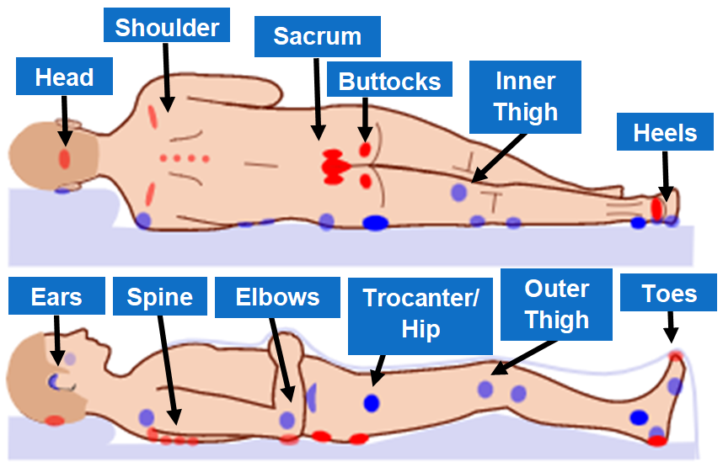
Parts of the Body Prone to Pressure Ulcers
Stacey Evans-Charles, 28/01/2023

Slide 20
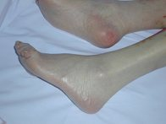
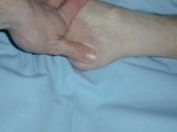
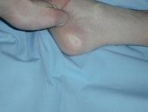
Categorisation of Pressure Ulcers
Blanchable Erythema (redness of the skin)
Visible skin redness that becomes white when pressure is applied and reddens when pressure is relieved.
Stacey Evans-Charles, 28/01/2023

Slide 21
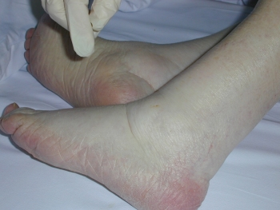
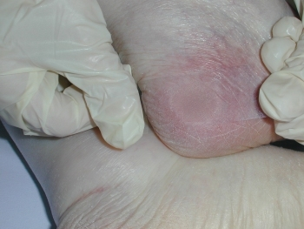
Categorisation of Pressure Ulcers
Non-blanchable Erythema
Visible skin redness that persists with the application of pressure from fingers palpating the area.
Non-blanchable erythema indicates structural damage to the capillary bed.
Stacey Evans-Charles, 28/01/2023

Slide 22
Categorisation of Pressure Ulcers
Stacey Evans-Charles, 28/01/2023

Slide 23
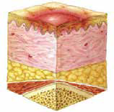

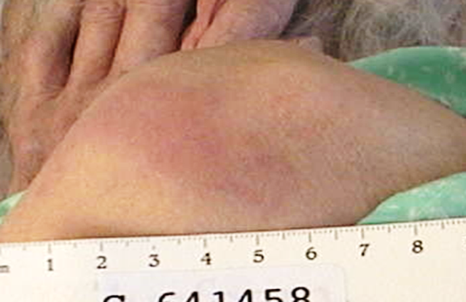
Categorisation of Pressure Ulcers
Category 1
Intact skin with non-blanchable redness of a localized area usually over a bony prominence.
Darkly pigmented skin may not have visible blanching; its colour may differ from the surrounding area.
The area may be painful, firm, soft, warmer or cooler as compared to adjacent tissue.
!
Category 1 may be difficult to detect for individuals with dark skin tones. May indicate persons “at risk”.
Stacey Evans-Charles, 28/01/2023

Slide 24
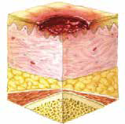
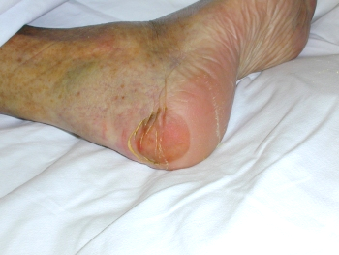
Categorisation of Pressure Ulcers
Category 2
Partial thickness loss of dermis presenting as a shallow open ulcer with a red pink wound bed, without slough. May also present as an intact or open/ruptured serum-filled or serosanguinous filled blister.
It presents as a shiny or dry shallow ulcer without slough or bruising*.
This category should not be used to describe skin tears, tape burns, incontinence associated dermatitis, maceration or excoriation.
!
*Bruising indicates Deep Tissue Injury (DTI)
1
1. https://www.nationalwoundcarestrategy.net/
Stacey Evans-Charles, 28/01/2023

Slide 25
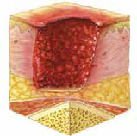
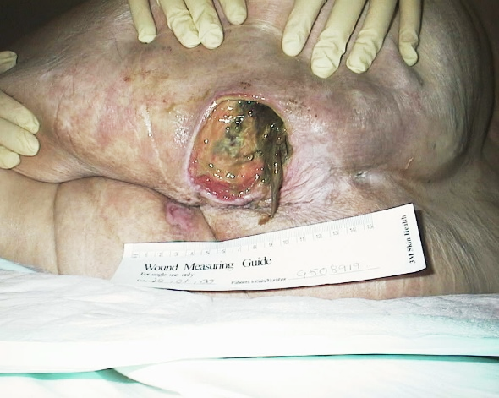
Categorisation of Pressure Ulcers
Category 3
Full thickness tissue loss. Subcutaneous fat may be visible but bone, tendon or muscle are not exposed. Slough may be present but does not obscure the depth of tissue loss. May include undermining and tunnelling.
The depth of a Category III pressure ulcer varies by anatomical location. The bridge of the nose, ear, occiput and malleolus do not have (adipose) subcutaneous tissue.
Category/Stage III ulcers can be shallow. In contrast, areas of significant adiposity can develop extremely deep Category/Stage III pressure ulcers.
Bone/tendon is not visible or directly palpable.
Stacey Evans-Charles, 28/01/2023

Slide 26
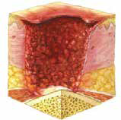
Categorisation of Pressure Ulcers
Category 4
Full thickness tissue loss with exposed bone, tendon or muscle. Slough or eschar may be present. Often includes undermining and tunnelling.
The depth of a category/Stage IV pressure ulcer varies by anatomical location. The bridge of the nose, ear, occiput and malleolus do not have (adipose) subcutaneous tissue and these ulcers can be shallow.
Category IV ulcers can extend into muscle and/or supporting structures (e.g., fascia, tendon or joint capsule) making osteomyelitis or osteitis likely to occur.
Exposed bone/muscle is visible or directly palpable.
1
1. https://www.nationalwoundcarestrategy.net/
Stacey Evans-Charles, 28/01/2023

Slide 27
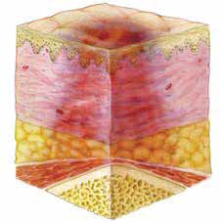
Categorisation of Pressure Ulcers
Deep Tissue Injury (DTI)
Purple or maroon localized area.
Although the appearance of DTI is often described as a bruise, it should be noted that a DTI does not go through the colour changes typical of a bruise as it resolves
Deep tissue injury may be difficult to detect in individuals with dark skin tones
(NHS Improvement 2018)
1
1. https://www.nationalwoundcarestrategy.net/
Stacey Evans-Charles, 28/01/2023

Slide 28
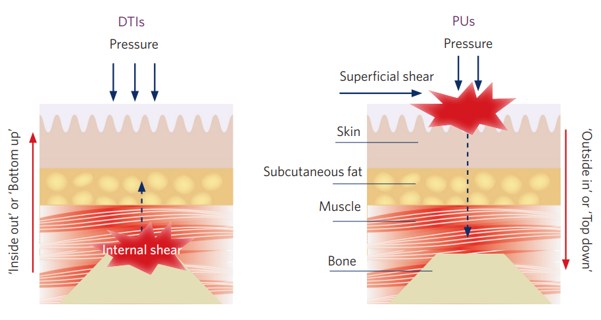
Differences in the Development of DTIs & PUs
https://www.wounds-uk.com
Stacey Evans-Charles, 28/01/2023

Slide 29
How is a DTI Managed?
Define objectives
Optimise patient condition
Offload the DTI
Reposition regularly
Manage Pain
Manage comorbidities
Keep patient clean and dry – moisturise dry skin
If skin is broken or open wound present, cleanse and cover with an appropriate dressing
Monitor and regularly assess
Refer as appropriate, e.g. to a tissue viability service, if DTI deteriorates rapidly
Educate the patient, family and carers
Document objectives and management strategies
Stacey Evans-Charles, 28/01/2023

Slide 30
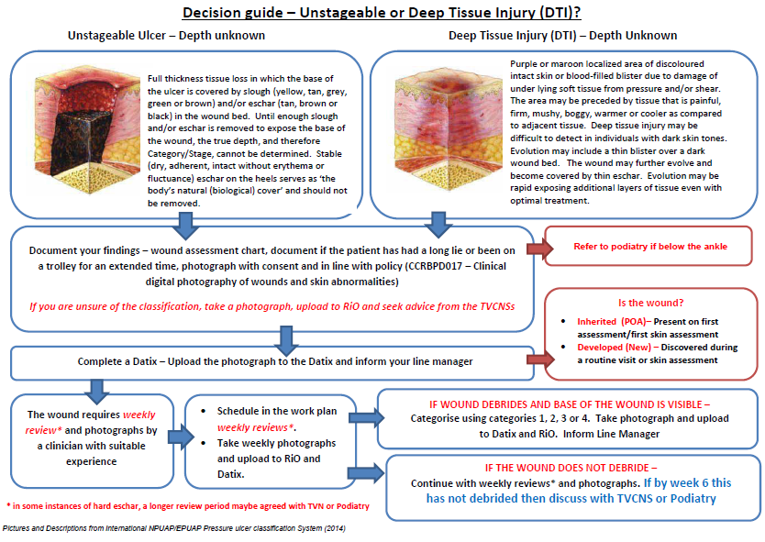
How is a DTI Managed?
Stacey Evans-Charles, 28/01/2023

Slide 31

Parts of the Bottom
Label the diagram and shade the area which is most likely to suffer from moisture damage.
Stacey Evans-Charles, 28/01/2023

Slide 32
Location
Level of Iliac Crests
Intergluteal Cleft
Buttock
Ischium Spine
Thigh
Gluteal Fold
Stacey Evans-Charles, 28/01/2023

Slide 33

Is It Incontinence Associated Dermatitis Or
A Pressure Ulcer?
What do you look for?
How can you tell the difference?
What factors do you consider?
Stacey Evans-Charles, 28/01/2023

Slide 34

Pressure and Moisture are
Prevented and Treated Differently
Think Pressure if:
Bony prominence
Defined edges
Necrotic tissue
Damage into the muscle layer
Immobile or restricted mobility
They have had an acute illness
Think Moisture if:
It’s in the natal cleft
The damage has an irregular shape
Incontinence
Urinary Tract Infection
Leaking catheter
Episode of diarrhoea
Fever
Stacey Evans-Charles, 28/01/2023

Slide 35
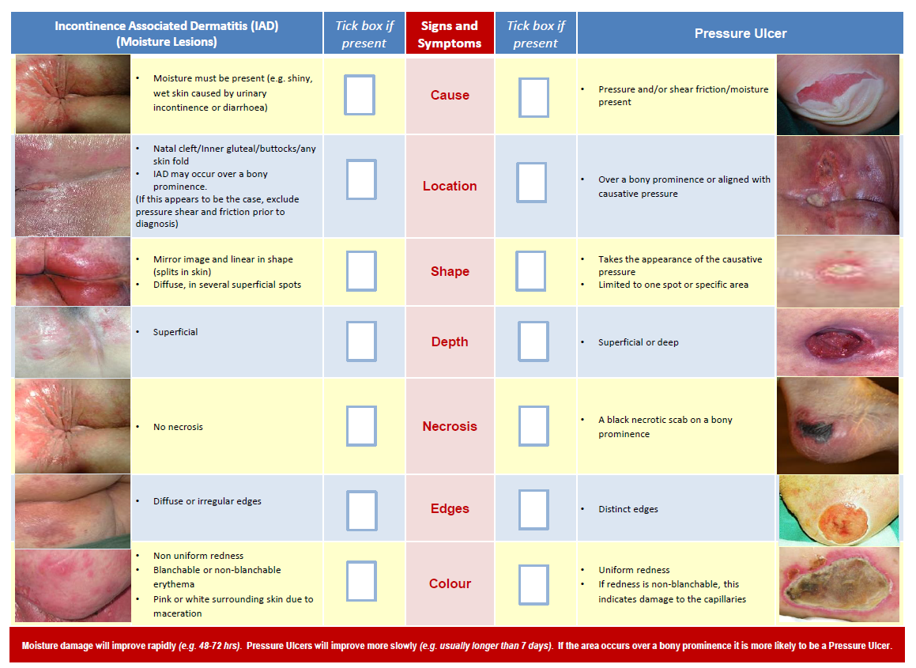
Stacey Evans-Charles, 28/01/2023

Slide 36
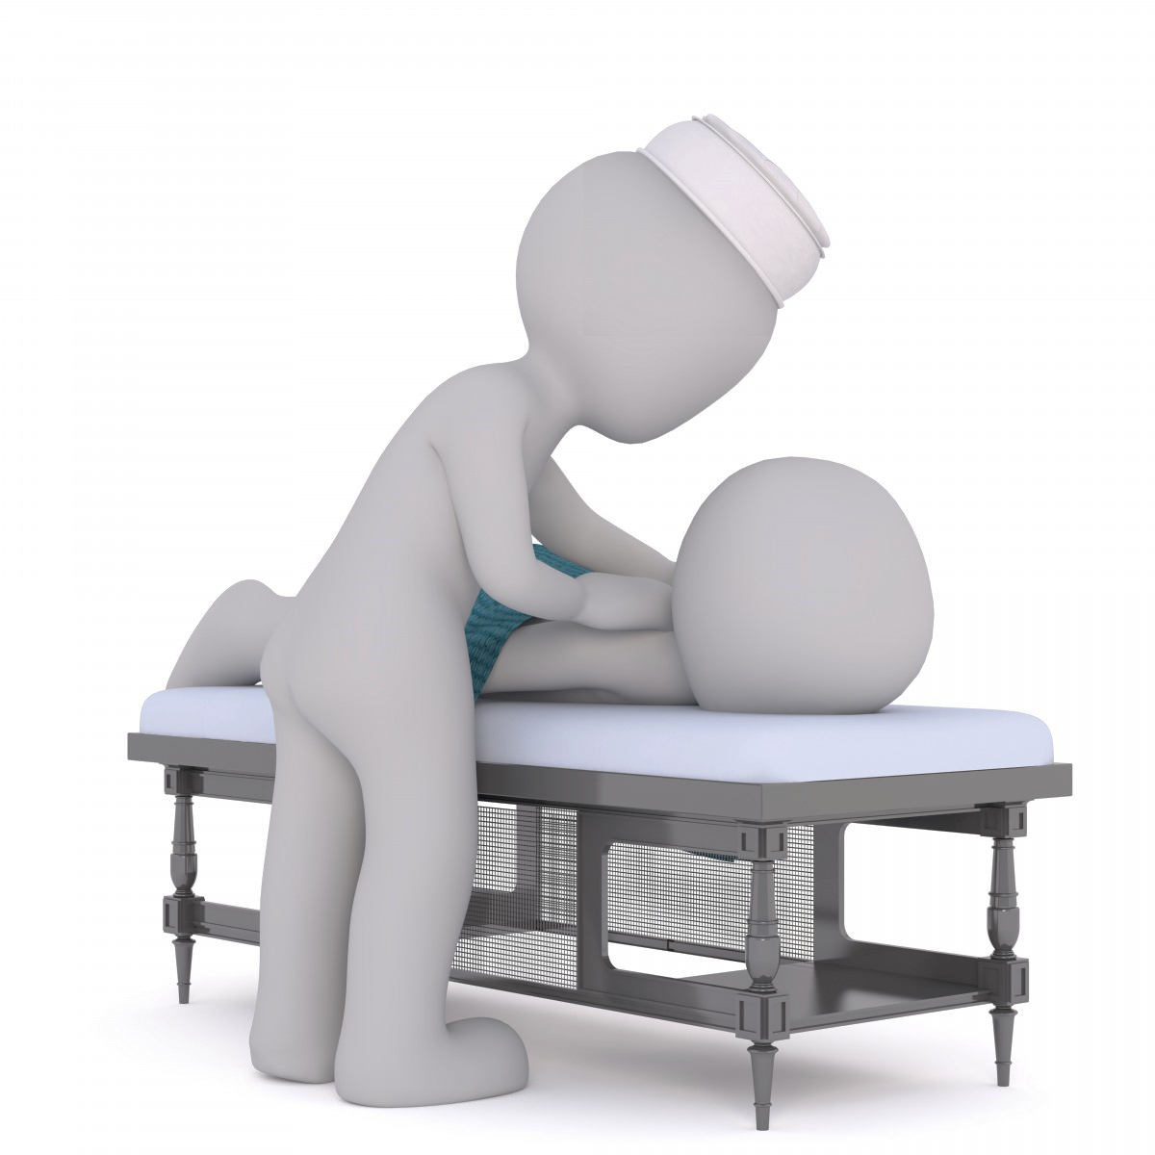
Further Advice…
Reposition the patient in such a way that pressure is relieved or redistributed
Avoid repositioning patient on bony prominences with existing pressure damage
Avoid subjecting the skin to pressure and shear forces
Avoid positioning the patient directly onto medical devices such as tubes drainage systems or other foreign objects
Do not leave an individual on a bed pan longer than necessary
Use 30° tilted side lying
Limit head-of-bed elevation to 30° for patients on bed rest (unless contraindicated)
Continue to reposition the individual regardless of the support surface (a minimum of 2 – 4 hourly)
If seating is necessary for patients with pressure ulcers on the sacrum/coccyx or ischia, limit seating to 3 times a day in periods of 60 minutes or less, with a pressure relieving cushion in place
Stacey Evans-Charles, 28/01/2023

Slide 37
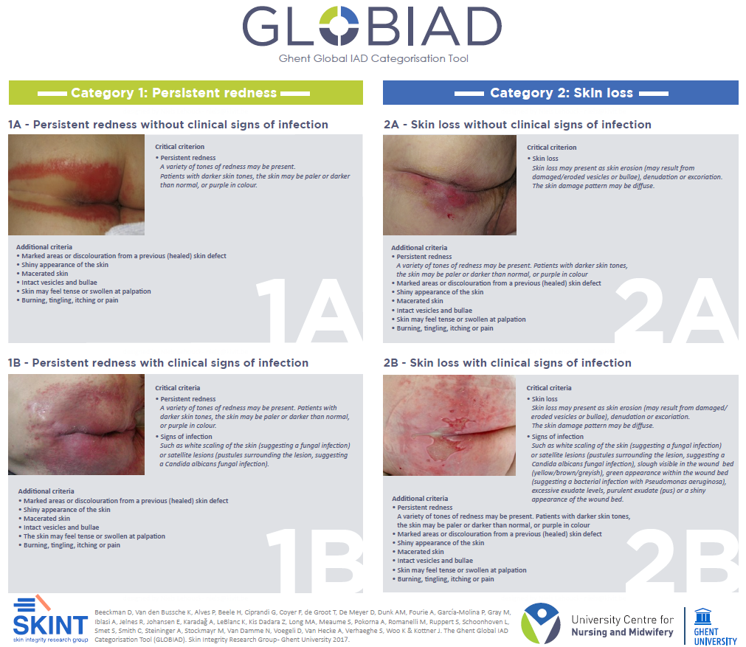
GLOBIAD IAD Categorisation
www.skintghent.be/en
Stacey Evans-Charles, 28/01/2023

Slide 38
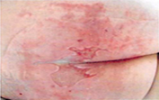
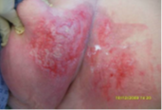
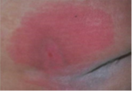

Incontinence Associated Dermatitis Pathway
SEVERE IAD
Wash skin with Medi Derma-Pro Foam and Spray Incontinence Cleanser and apply Medi Derma-Pro Skin Protectant Ointment after each episode of incontinence.
Step Up
Step Down
MODERATE IAD
Wash skin with suitable skin cleansing agent and pat dry after each episode of incontinence. Apply Medihoney barrier cream, if mild fungal infection or less than 50% skin damage (leave 5 minutes to dry before applying barrier cream). Medi Derma S Barrier Film can be applied if there is no clinical evidence of infection.
MILD IAD
Wash skin thoroughly with suitable skin cleansing agent and pat dry after each episode of incontinence. Apply a pea-sized amount of Derma-S Total Barrier Cream after every third wash.
PREVENTATIVE
Wash skin with suitable skin cleansing agent and pat dry after each episode of incontinence. Apply emollient to optimise skin health.
Stacey Evans-Charles, 28/01/2023

Slide 39
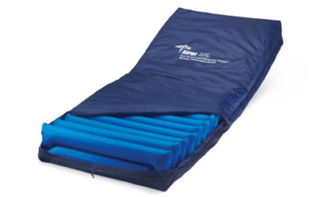
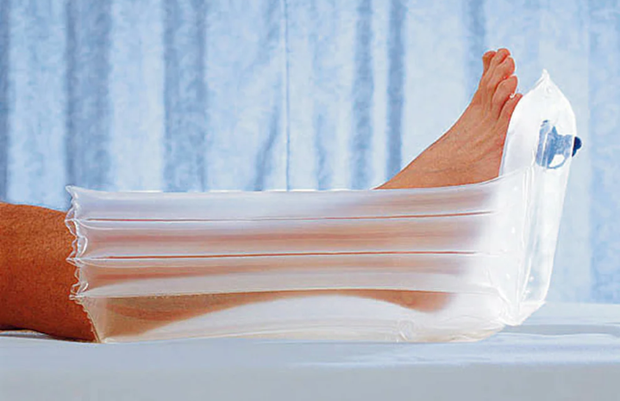
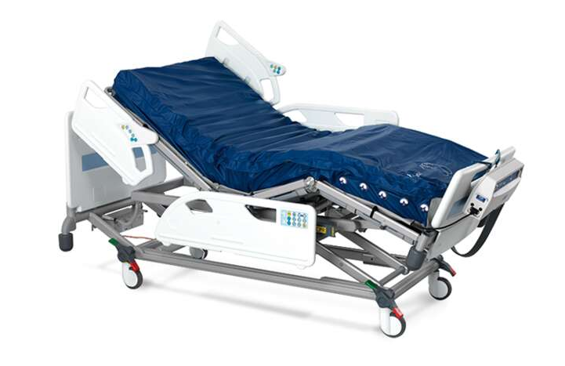
Surface
Support surfaces alone neither prevent nor heal pressure ulcers. They are used alongside a management plan for pressure ulcer prevention and treatment. The following points should be considered:
Assessment of the appropriateness and functionality of the support surface on every encounter.
Continue to reposition patients placed on a pressure redistribution support surface.
Apply Repose boots where necessary, as this reduces the risk of pressure damage to the heels. Repose boots are designed for use in bed or with the feet elevated.
Place legs on a pillow to “float” heels off the bed.
Use an “active support surface” (overlay or pressure redistribution surface) for individuals at higher risk when frequent manual repositioning is not possible.
Foam mattresses can be used for individuals with Category 1 and 2 pressure ulcers, depending on their Braden score and use of clinical judgement.
Stacey Evans-Charles, 28/01/2023

Slide 40


Keep Moving
Reposition all patients who are at risk of, or have, pressure ulcers (unless contraindicated)
When determining the frequency of repositioning, your patient considerations should be given to:
Level of activity, ability and mobility
General medical condition
Overall treatment objectives including
  Skin condition and any evidence of previous pressure damage
  Comfort of patient
Encourage and educate patients and family/carers/friends of the importance of repositioning – give each patient the Patient Information Leaflet on first contact
Encourage independent repositioning where possible
Stacey Evans-Charles, 28/01/2023

Slide 41

Nutritional Assessment: MUST
Undertake a nutritional assessment as per hospital policy (5 days using MUST tool
Use red trays where necessary
Consider referring patients screened to be at risk of malnutrition and patients with existing pressure ulcers to a dietician
Ensure meals are in reach for patients who can feed themselves
Provide enhanced foods and/or oral supplements between meals if required (discuss with medical team)
Assess the patient’s ability to eat independently
Stacey Evans-Charles, 28/01/2023

Slide 42
Reporting When Care Goes Wrong
Datix- Category 2/3/4/unstageable and DTI
Category 2A and 2B Incontinence Associated Dermatitis (IAD)
Contact TVN when you have followed the pathway for managing IAD and there is no improvement with the patient’s skin integrity
Where pressure ulcer care is complex
Safeguarding if there is suspicion of neglect
Duty of Candour (DoC) as per Trust Policy
Stacey Evans-Charles, 28/01/2023

Slide 43

Your role involves…
Being preventative
Ensuring patients are given the right information, at the right time to make the right decision
Correct assessment
Correct escalation
Sepsis recognition and management in line with Trust policy
Knowing when to refer to specialist services
Providing advice and education for relatives
Adhering to Trust policy and procedures
Stacey Evans-Charles, 28/01/2023

Slide 44

Quiz
Q. What are pressure ulcers?
Q. Where do pressure ulcers commonly occur?
Q. List five patient types deemed at risk of developing pressure ulcers
Q. What is blanchable and non-blanchable erythema and why do we need to know and document this?
Q. List the characteristics of PU and IAD
Q. What does aSSKINg stand for?
Q. What assessment tools do we use in BHFT?
Stacey Evans-Charles, 28/01/2023

Slide 45

Thank you
questions…
Stacey Evans-Charles, 28/01/2023

