Slide 1


Understanding Dementia Course
Driving
Firearms Licence
Presenter:
Dr Nicholas Woodthorpe
Consultant Psychiatrist
Wokingham Memory Clinic

Slide 2
Driving and cognitive impairment
The word ‘cognitive’ refers to brain functions including:
Memory
Attention
Problem-solving
Speed of thinking
Visuo-spatial ability
Multi-tasking ability to make sense of what you see (including reading ability)
Driving requires good overall cognitive abilities

Slide 3
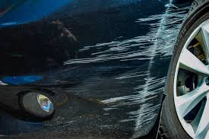
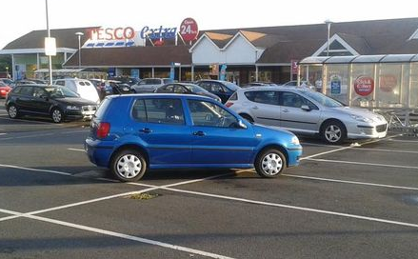
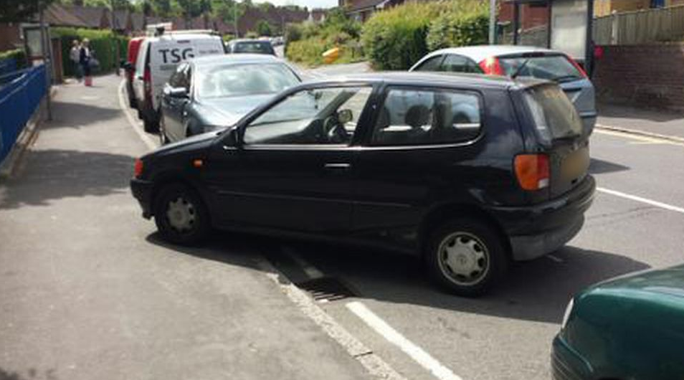
Warning signs – when to stop driving
Scrapes or dents on the car, garage or gates
Hitting kerbs
Parking inappropriately
Trouble navigating turns
Moving into the wrong lane
Confusion at exits
Driving at inappropriate speeds
Delayed responses to unexpected situations
Not anticipating potentially dangerous situations
Increased agitation or irritation when driving
Getting lost in familiar places
Confusing brake and accelerator pedal
Near misses / incidents
Incorrect signalling

Slide 4
Assessing driving ability
Driver realises
Eye witnesses
Dash Cam
Driving assessment
Cognitive tests can provide an indication

Slide 5
Some alternatives to driving
Taxis
Walking
Cycling
Electrical scooters
Bus for regular routes
Dial-a-ride bus service (for example, Readibus)
Internet shopping
Hospital transport when required
Using direct debit to pay bills rather than in person at a bank or post office

Slide 6
Benefits of not driving
Save money
  No running costs including depreciation
  If you drive less than 2500 miles per year it is cheaper to use taxis than run a car
  If you drive less than 4000 miles per year it is cheaper to use a mixture of public transport and taxis than use a car
Less stress
Wellbeing

Slide 7

Outcome of memory clinic assessment
No concerns regarding driving
Possible concerns over driving
Definite concerns and advised to stop driving

Slide 8
Driving licence holders have a legal duty
Notify the DVLA of any injury or illness that would have a likely impact on safe driving ability
Respond fully and accurately to any requests for information from either the DVLA or healthcare professionals
Comply with the requirements of the issued licence, including any periodic medical reviews indicated by the DVLA

Slide 9
The DVLA process
The DVLA will send out a form asking the driver to re-apply for their licence
The driver will need to complete a medical questionnaire and medical consent form
The DVLA will usually request a medical report from the person’s GP or specialist
The driver may have to attend for a formal driving assessment
If renewed, the licence will be valid for 1 year
Visit the gov.uk website to find out more
www.gov.uk/dementia-and-driving

Slide 10
Firearms guidance
The owner of a firearm or shotgun licence is required to declare any conditions that could affect their suitability to posses a firearm or shotgun. Relevant conditions include dementia.
Visit the gov.uk website to find out more
Police Guidance
www.gov.uk/guidance/firearms-licensing-police-guidance
Firearms Security guide
www.gov.uk/government/publications/firearms-security-a-brief-guide

Slide 11
Thank you
questions…

