Slide 1

Understanding Dementia Course
Supporting physical wellbeing
Washing & Dressing
Eating & Drinking

Slide 2
Washing & Dressing
Difficulties may relate to………..
The number of steps involved in the task
aim to cut out some of the steps e.g. run the bath / put toothpaste on brush etc.
Recognising and finding items needed
leave out only the items needed, or you may need to hand items …”here’s your toothbrush” etc.
Getting started and staying focussed
you may need to prompt step by step
NB. in the order they are used to doing things wherever possible
Notes:
Number of steps – may need e.g. to run bath or to put toothpaste on brush
Recognising items – may need to clear away all but items needed – even hand items “here is yout toothbrush”
Getting started – you (or someone else) may need to prompt
Remembering (see next slide)
NB DISCUSS THE ORDER IN WHICH EACH INDIVIDUAL HABITUALLY WASHES / GETS DRESSED
IT WOULD ‘FEEL WRONG’ IF WE CHANGED THE ORDER
SO IF WE PROMPT IN THE ‘WRONG’ ORDER FOR THE PERSON THEY MAY BE UNWILLING TO CO-OPERATE

Slide 3
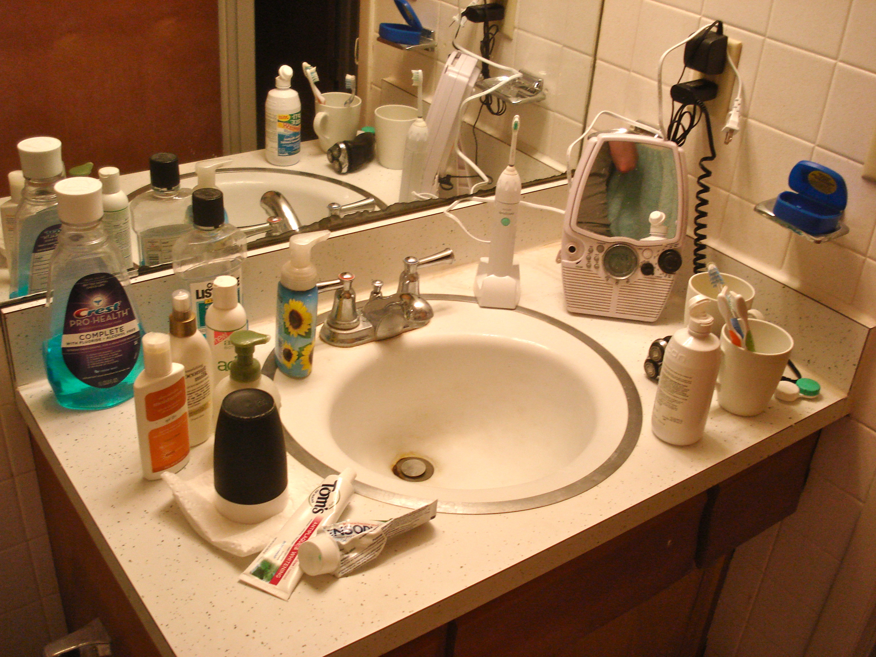

Slide 4
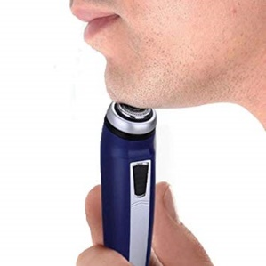
The person believes they have had a bath, changed their clothes etc. – some ideas that may help….
Is there a best time of day?
Routine plus gentle advance warning may help
If assistance needed – who is the best person to do this?
Weekly baths as part the care plan in a day centre or care home
Realistic expectations e.g. weekly rather than daily bath / sponge wash
Clothing – duplicate favourite outfits
Electric razor rather than wet shave
A non-confrontational approach
Notes:
Promote Group discussion over how people have dealt with this
i.e. Ideas to get over refusal to wash / change clothing ( based memory loss / confusion / belief that they had already done it)
Communication strategies
Prompt but don’t argue
Reminders / Advance warning – help them to get used to the idea “Its Wednesday so you’ll be having your bath later on won’t you etc”
Respectful approach (sensitive issue – are you saying I’m dirty / I smell)
Routines / best times of day
Is there a time of day when the person is most alert / most active
Culture (re nudity)
Best person to help
Family member / Professional
Male / female
Realistic expectation
Bath, shower or strip wash?
Do they need to have a bath every day?
Shaving (wet shave/electric razor)
Laundry issues
Remove dirty clothing when opportunity arises (washing / night)
Duplicate ‘favourite’ outfits
Mum would never have gone out looking like that!
Motivation
Discuss mood / identify depression & treat / apathy & reduced motivation as part of dementia

Slide 5
The physical demands of washing / dressing / managing zips & buttons etc.
Bathing aids - contact Social Services and ask for an Occupational Therapy assessment for grab rails / raised toilet seat / perching stool / bath board / bath or shower seat
Would pain relief prior to bathing help?
Aim for clothing that is easier to take on and off
Make sure the bathroom is warm, well lit and feels comfortable and inviting

Slide 6

Eating / Drinking
Early difficulties
Forgetting to eat / difficulties with shopping / cooking / safe food storage / hygiene (washing up)
Possible solutions
Home help
Ready meals
Meals on wheels
Home delivery meal service
Day Centres / Luncheon clubs / Lunches out
Internet shopping supported by family / friends
Labeling and written notes & reminders
Notes:
Mention:
MOOD – reduced appetite
DENTAL CARE – leaflet in handout including community dental clinic contact
FROM THIS POINT PRESENT GROUPS OF SYMPTOMS – ONLY COVER TIPS TO HELP IF ANYONE IN GROUP IS CARING FOR SOMEONE WITH THOSE SYMPTOMS

Slide 7
Clumsy / slow eating
Visual difficulties e.g.
noticing, recognising and locating food & drink
Plate guard – nonslip mat
Adapted crockery or cutlery / exchange knife and fork for spoon (and fork)
Plastic tablecloths / napkins
Cut up food / finger foods
Heated plates / insulated mugs
Start the action
Lighting
Verbally draw attention to items
Turn plate during meal
Contrast food / plate / table
For hallucinations – follow tips as above / reassure / discuss with GP

Slide 8
Agitation & restlessness –
eating too little
Compulsive eating –
eating too much & too fast
Simplify table setting
Calm atmosphere
Don’t assume they have finished
Heated plates / insulated mugs
Finger foods
Frequent snacks / Enriched foods
Smaller portions / plates / cutlery
Verbal (+ physical) prompts to slow down
Verbal reminders to chew / swallow each mouthful
Keep food out of sight
Low calorie snacks
Remove hazards
Distraction

Slide 9
Drink alcohol within recommended levels (if at all)
Recommended NHS levels are a maximum of 14 units each week for both men and women spread over three or more days. Safe drinking levels for older people are probably less than this
Factors such as previous habits, memory problems (forgetting they have had a drink) or changes in behaviour or mood may lead to a person with dementia drinking too much
Some tips to try to limit alcohol consumption:
Try using smaller glasses
Drinks with lower alcohol content
Zero alcohol wines and beers
Watering down drinks
Keep bottles of spirits less than a quarter full (top up rather than replacing with a full bottle when empty)
Notes:
(14 units is the same as 4 or 5 large glasses of wine over the week, or seven pints of beer or lager with lower alcohol content)

Slide 10

Problems with chewing and swallowing
Ask GP to exclude mouth ulcers and oral thrush
Arrange regular dental checks at your own dentist
If this is becoming difficult, contact Berkshire Healthcare Trust Community Dental Service for a home visit
Look out for warning signs of a swallowing problem (dribbling / coughing when eating and drinking / gurgly voice / frequent chest infections)
If concerned ask GP to refer for a swallowing assessment

Slide 11
Time for our next break
Further questions / discussion points?

