Slide 1
Memory and Communication
Part 2

Slide 2
John is an 87-year old man with dementia.
He lives in a care home and has two children who are grown up.
He can get upset, frequently saying “I need to go home, my children are waiting for their tea.”
How might you respond?

Slide 3
What do I say if the person I care for is:
Saying things that aren’t right / true or accusing people of things (e.g. stealing or hiding things)
Wanting to do something they used to do in the past (collecting children from school / going to work)
Wanting to see someone from their past
Asking to ‘go home’ when they are at home
Not recognising me / not accepting who I am.

Slide 4
Our options…
To CORRECT
To DISTRACT
To GO ALONG WITH…
(Taking the way the person is feeling seriously and focussing on this rather than the facts)
To TELL A ‘WHITE LIE’ sometimes referred to as ‘a therapeutic lie’

Slide 5
Correcting
This is the obvious response when someone gets something wrong……
It may be helpful for someone with a mild dementia …….
(that’s a relief… now I’ve got my facts straight!)
but, if s/he gets upset or angry, or doesn’t
believe you……
then we need to work out a different way of responding

Slide 6
Distracting
Changing the subject
Introducing an activity
“Let’s just have a cup of tea first”…
“Can you just give me a hand with….”
Reminiscing (about the person/place/or event)
e.g. If s/he is asking for someone – talk about that person rather than responding directly
… so to the question “Where’s Mum?” you could say: “I remember you told me that your Mum liked dancing….”

Slide 7
Going along with…
Taking the way the person is feeling seriously and focussing on feelings rather than facts
Don’t argue with the person’s reality - think CONNECT instead of CORRECT
e.g. to…“You’ve stolen my watch!”
“I can see you’re upset…….when did you last see it ?..... remind me what it looks like?.....did it have a leather strap? …. where did you get it?” etc.
Once s/he is calmer you may be able to slip into the past tense and start to reminisce
e.g. “you needed to be on time when you worked for the bank… you really enjoyed your job didn’t you etc.”

Slide 8
The ‘white lie’ or ‘therapeutic lie’
Is it ever OK not to tell the truth?
Is it sometimes in the person’s best interests?
Is it sometimes in YOUR best interests?
What are the risks of NOT telling the truth?

Slide 9
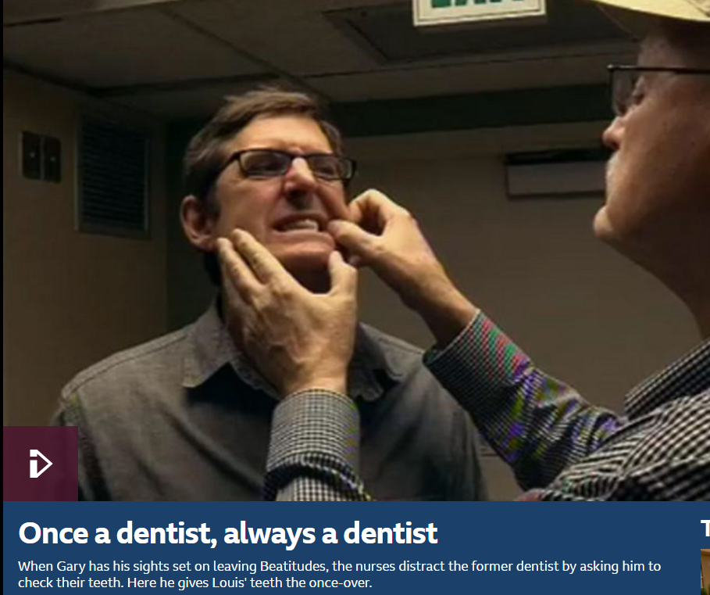
The SPECAL Approach
Stands for Specialised Early Care for Alzheimer’s
Try not to contradict the person’s reality
Find answers (to repeat questions) that make sense within their reality (whether or not they are really true)
Identify an area in which the person with dementia is an expert, and deliberately switch to this topic if you pick up that they are feeling isolated or agitated
Create links between past memories to create a world that makes sense to the person.
Journalist Louis Theroux created a documentary about living with dementia.
It is available through the BBC iPlayer app.
www.bbc.co.uk/programmes/p00rgkw1

Slide 10
John is an 87-year old man with dementia.
He lives in a care home and has two children who are grown up.
He can get upset, frequently saying “I need to go home, my children are waiting for their tea.”
How might you respond?

Slide 11
Questions and
discussion

