Slide 1
Understanding Dementia Course
Ideas on reducing stress
& the importance prioritising your wellbeing
Part 4

Slide 2
Most of us want to be the best carer that we can be
With the best will in the world some people are more temperamentally suited to
a caring role than others
Relationships vary – some people will have been very close to the person they are
now caring for – others less so
Balance your time – You may have to prioritise how much time you can care for another person against other demands on your time e.g. childcare / other important relationships etc.
Be honest – with yourself and with others – about how much you can do
Don’t ignore your own needs – the more stressed you become the less you
will be able to hit that ‘pause button’ / focus on your values / and choose how to respond.

Slide 3
Burnout
Burnout is a state of emotional, physical, and mental exhaustion caused by excessive and prolonged stress
It occurs when you feel overwhelmed, emotionally drained, and unable to meet constant demands
Eventually, you may feel like you have nothing more to give – that you no longer care

Slide 4
How to de-stress – to make sure you have enough resources to balance the seesaw?
The flower diagram applies equally to you!
Go for a walk (or a run)
Read a book
Walk the dog
Do some gardening
Listen to music
Meet your friends
Paint a landscape
Crosswords / Sudoku / Ken Ken
Play a round of golf
Visit a spa
Go for a swim

Slide 5
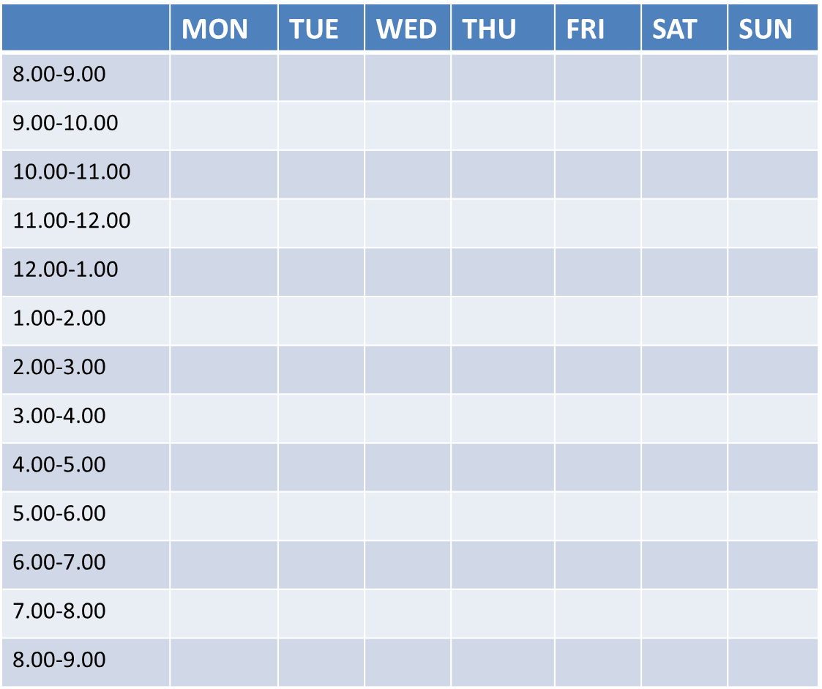
Making time for the things you enjoy
Complete a diary of your activities for a week.
Review your completed diary
What activities are
enjoyable/pleasurable/soothing?
necessary/routine activities?
Ask yourself
Is there a balance - are the “taps” that empty
my ‘stress bucket’ present?

Slide 6
And if the answer is no?
Think about when and how you could schedule some pleasurable/enjoyable activities into your week:
What resources would you need (other people/practical things) to make this happen?
What is the first small step you can make?
When can you take this first step?
It can be useful to repeat this diary exercise from time to time in the future
What are you doing more/less of?
Are you still managing to find time for pleasurable/soothing activities?
Have any “taps” disappeared from your week?
What would you like to change?

Slide 7
Values as your compass
In a stressful situation, if you simply respond based on what you are thinking & how you are feeling in that moment, life can be an emotional roller coaster.
The more stressed you become, the more likely you will be to get caught up in this
Try instead to:
Acknowledge your feelings and difficult thoughts, but don’t beat yourself up about them – they are probably understandable in the circumstances
Try to find a pause button - i.e. something that helps to shift your attention away from your thoughts and feelings (on the basis that what you pay attention to grows bigger)…
To give you time to hook into your values (your compass as to how you would like to respond)….and so to choose a behaviour consistent with your values.

Slide 8
Finding a pause button that
works for you
Some people suggest counting to 10…
The problem is we can do this without much thought…
Something that engages the brain more, is likely
to be more successful in helping us to shift our attention
e.g. try counting backwards from 100 in 7’s!
Many carers find that practicing
Mindfulness and Relaxation exercises helps in reducing
stress and in enabling them to choose what they pay attention to

Slide 9
Tuning in: Mindfulness
Notes:
Noticing what are our thoughts, feelings, and sensations in the present moment

Slide 10
What does Mindfulness involve?
Maintaining a moment-by-moment awareness of our thoughts, feelings, bodily sensations, and surrounding environment
Learning to pay attention and to tune in to what is going on in our mind and body without judging our experience
Help us to tune in to what is happening and then choose how we want to respond, and can improve our quality of life
Lots of research evidence that mindfulness can help with depression and stress
Notes:
At tune in talk about not relaxation, tuning out, easing physical tension, slowing the mind down- mindfulness is…

Slide 11
Medical Practitioner, Psychotherapist, Life Coach. Russ Harris, author of the
international best-selling self-help book 'The Happiness Trap', is a world-renowned
trainer of Acceptance & Commitment Therapy (ACT)
He outlines benefits of practicing Mindfulness as follows:
To be fully present in the here and now
To become less disturbed by and less reactive to unpleasant experiences
To learn the distinction between you and your thoughts
To have more balance less emotional volatility
To experience more calm and peacefulness
To develop self acceptance and self compassion

Slide 12
Mindfulness
There are different types of mindfulness exercises. Here are some examples for you to try:
Focus on breath (audio 4 mins):
Web www.cntw.nhs.uk/resource-library/relaxation-techniques/f_04_mindful-breathing/
Body scan (14 mins)
Web https://youtu.be/4_nioG63OSs
Dropping the Anchor (4.36 mins)
Web https://m.youtube.com/watch?v=XF2ZXyrOGyg
3 minute breathing space (3 mins)
Web https://youtu.be/4_nioG63OSs
Loving kindness meditation (6 mins)
Web https://youtu.be/YSNNKYZLX54
Notes:
How did you find that?
Direct you to some websites at the end

Slide 13
Tuning out: Relaxation
Many people find relaxation exercises helpful in coping with stressful situations
Notes:
Changing the physical sensations we are experiencing

Slide 14
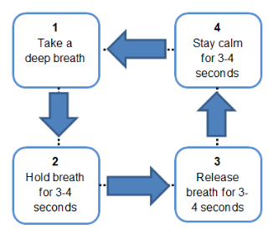
Relaxation: Breathing techniques
Relaxed breathing is slower and deeper than ‘normal’ breathing.
There is an NHS YouTube video you can watch for guidance.
Search for ‘NHS Videos – Relaxation – Breathing Techniques’
or
Enter this URL into your internet browser: youtu.be/GqfrbGtorBE
Notes:
When we are stressed, our breathing speeds up. Relaxed breathing is when we consciously slow down and deepen our breathing

Slide 15
Relaxation:
Progressive muscle relaxation
Active
Tensing and relaxing major muscles groups in the body.
Can help us to learn where we carry tension in our body and how to release tension from our body.
Example audio (8mins):
Web www.wolverhamptonhealthyminds.nhs.uk/self-help/relaxation-audio-mp3
Notes:
Major muscle groups in the body are alternatively tensed and relaxed - Aim to notice the difference between feelings of relaxation and feelings of tension - Some people find when they are relaxed their muscles feel heavier and warmer, while others find their muscles are lighter
Helps us to become better aware of the tension in our body
We will carry our muscle tension in different parts of the body
This exercise might help you to learn what particular muscle groups you should be aware of to clue you in to when you are starting to feel stressed
People can find this exercise relaxing because they learn how to release tension from the body

Slide 16
Relaxation:
Progressive muscle relaxation
Passive
Thinking about relaxing the muscles, sometimes suggestions of warmth or heaviness.
Example audio (8 ½ mins)
Follow this link, or copy it into your internet browser:
Web www.yorkhospitals.nhs.uk/seecmsfile/?id=1500

Slide 17
Relaxation: Visual imagery
Imagery can be a powerful tool to activate feelings associated with the real experience
Imagining any scene/ place where you feel calm
and relaxed e.g., beach, country walk, cloud
Example audio: (9 mins)
Guided beach visualisation
Follow this link, or copy it into your internet browser:
Web www.rbht.nhs.uk/sites/nhs/files/MP3s/Guided%20beach%20visualisation.MP3

Slide 18
More exercises and practices
Mindfulness practice
A variety of mindfulness exercises:
Web https://soundcloud.com/hachetteaudiouk/sets/mindfulness-a-practical-guide-to-finding-peace-in-a-frantic-world
Relaxation practice
Audio files of relaxation techniques that can help relieve stress and gain a sense of wellbeing: Web www.ntw.nhs.uk/resource-library/relaxation-techniques/
Free NHS recommended relaxation apps
Thrive: Feel Stress Free: uses games to track your mood and teach you methods to take control of stress and anxiety: Web www.nhs.uk/apps-library/thrive-feel-stress-free/
Feeling good: positive mindset uses audio tracks to help relax your body and mind.
Web www.nhs.uk/apps-library/feeling-good-positive-mindset/

Slide 19
Sources of help and support
For extra support with stress, low mood, or worry:
Self-help leaflets
Self help leaflets on common mental health problems, including stress, sleep, anxiety and controlling your anger: https://web.ntw.nhs.uk/selfhelp/
Talking Therapies
Range of therapy support options, including Stress Less workshops, and self help guides.
Individual and group support via phone and video call available
You can self-refer online or by calling them
Web www.talkingtherapies.berkshirehealthcare.nhs.uk/
Call 0300 365 2000

Slide 20
And finally … hidden gems?
We have focussed mainly on negative changes in behaviour – whereas some changes in behaviour may be a positive.
Can you think of any unexpected plus sides or lighter moments relating to some of the new behaviour in the person you care for?
We would be delighted if you would be happy to share these with the group.
Thank you for taking part in this session

