Slide 1
Understanding Dementia Course
Part 3

Slide 2
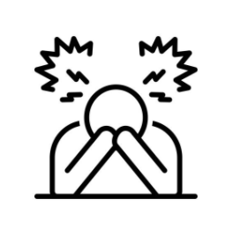
Your wellbeing
Identifying the symptoms of stress
The impact of stress on our ability to act in a way that is consistent with our values as a ‘carer’

Slide 3
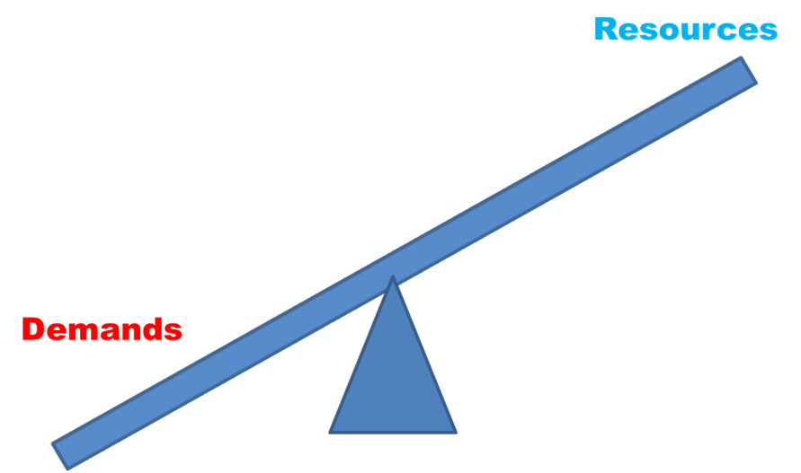
What is stress?
Stress arises when there is a lack of balance between demands and resources.

Slide 4
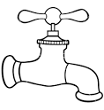
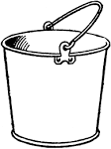
Stress bucket
Getting relative up and dressed
Going to work/ or voluntary commitments
Running the house
And so on…
Things that help you- talking to others
Having a break from caring responsibilities
Doing things you enjoy
Physical Exercise
Relaxation exercises

Slide 5
Symptoms of Stress
Physical signs / sensations (in the body)
Emotions and feelings
Cognitive and thoughts (in your mind)
Behaviour (what you do)

Slide 6
Symptoms of stress
Physical signs
Headaches | Dry mouth
Muscle tension | Sweating
Tension/pain in neck and shoulders | Feeling dizzy
Tension in arms and fist | Changes in appetite
Tension pain in lower back | Bladder problems
Tingling in the body | Constipation/diarrhoea
Tight jaw/grinding/clenching teeth | Difficulties sleeping
Raised heart rate | Tiredness
Increased breathing/breathlessness | Sexual difficulties

Slide 7
Symptoms of stress
Emotions and feelings
Irritable | Frightened
Anxious | Overwhelmed
Tense | Ashamed
Low | Guilty
Lack of interest | Feeling bad about yourself

Slide 8
Symptoms of stress
Mind and thoughts
Ruminating about /dwelling on past events
Worrying about events in the future
Racing thoughts
Difficulties concentrating
Memory lapses
Difficulties making decisions
Unable to think clearly

Slide 9
Symptoms of stress
Behaviour- what you do
Lose temper | Blame other people
Drink or smoke more than usual | Do not complete tasks
Change in eating habits | Avoid other people
Withdrawing from usual activities | Being snappy

Slide 10
Symptoms of stress
You are not alone
Cognitive Behavioural Therapy (CBT)
Symptoms are interrelated
What we think, affects how we feel (in terms of emotions and physical sensations) and what we do, that is how we behave

Slide 11
Situation
Person with dementia repeats the same question
Carer’s Thoughts
I shouldn’t shout
I’m a bad husband/son/
wife/daughter
I’ve told you already
Why can’t you
remember
Why don’t you listen
Carer’s Feelings
Carer’s Physical Sensations
Shout
Lose temper
Increased heartrate
Muscle tension /headache
Carer’s Feelings
Eat cake/chocolate
Smoke/have a drink
Hide away/withdraw
Fluttery stomach
Feeling shaky
Frustrated, irritated, cross, angry, sadness
Guilty/ashamed
Angry at self

Slide 12
Situation
Person with dementia repeats the same question
Carer’s Thoughts
I’ve told you already
Why can’t you
remember
Why don’t you listen
Carer’s Feelings
Carer’s Physical Sensations
Shout
Lose temper
Increased heartrate
Muscle tension /headache
Carer’s Feelings
Frustrated, irritated, cross, angry, sadness
My Values – what kind of
carer would I like to be?

Slide 13
Questions / Break time
Suggested discussion topic – what kind of carer would I like to be?

