Slide 1
Understanding Dementia Course
What it might feel like to have dementia &
How to identify triggers to situational behaviours
Part 2

Slide 2
Summary of Part 1 & Aims of Part 2
Some new behaviours are constant and the result of changes in the brain
Others come and go and are more likely to be situational – arising from feelings and unmet needs
In these next slides we will look at some tips for working out what might be going on and on what might help, and we will work through 3 practice scenarios

Slide 3
Put yourself in their shoes – how would you think and feel, what would you need?
Identifying possible triggers and patterns - things to think consider:
How are their psychological needs being impacted by their dementia?
What do I know about this person that might provide some clues
Are there any environmental and/or physical factors that could be adding to the situation?
Might I be doing anything to add to the situation? / Are my expectations realistic?

Slide 4
1. Our psychological needs What we all need in order to be happy
To feel connected to family and close friends
To feel comfortable and at home
Think about how dementia may be making it more difficult for the person you care for to meet their needs in each of these areas?
To feel worthwhile and valued
To keep up a social network club / hobbies
Professor Tom Kitwood
To have things to do and a sense of purpose

Slide 5
2. Consider what you know about the person that might provide some clues
What is important to them?
How do they see themselves?
What events in their past have shaped them?
How has the dementia impacted on them?
Do they have other health difficulties or illness?
Do they have mental health difficulties?
How is their eyesight and hearing?
What do they need?

Slide 6
3. Are there any environmental and/or physical factors that could be adding to the situation?
Things to think about:
Is there too much noise?
Are they being rushed?
Are they unwell / tired / in pain / too hot / too cold / hungry / thirsty?
Recognising patterns:
Things to think about:
Is the behaviour at a particular time of day
With a particular person
In a particular place
In response to a particular activity
Notes:
What would you think / how would you feel if……
you are being expected to pay a bill for services you don’t need or want
… you visit a member of your family and find a valuable ornament in their house that belongs to you
… a close friend suddenly stops coming to visit you or to answer your phone calls
…you live alone and have gone to bed – during the night you hear someone moving around your house

Slide 7
4. Ask yourself: might I be doing anything to add to the situation? / Are my expectations realistic?
It can be incredibly difficult to accept that the person you love may be changing in terms of their:
Ability to fulfil a previous role e.g. of loving & supportive spouse / wise & dependable parent / loyal friend etc.
Increasing dependency
Levels of intimacy - there are many different forms of intimacy, not just physical but emotional / intellectual / spiritual / recreational & social
Just as a person with dementia may deny their difficulties as a way of protecting themselves from having to acknowledge their difficulties…..
So too some spouses / sons / daughters may be expecting too much of their loved ones because they are findings the reality difficult to come to terms with
Accessing support through family and friends or carers groups can help, and some people may benefit from counselling.

Slide 8
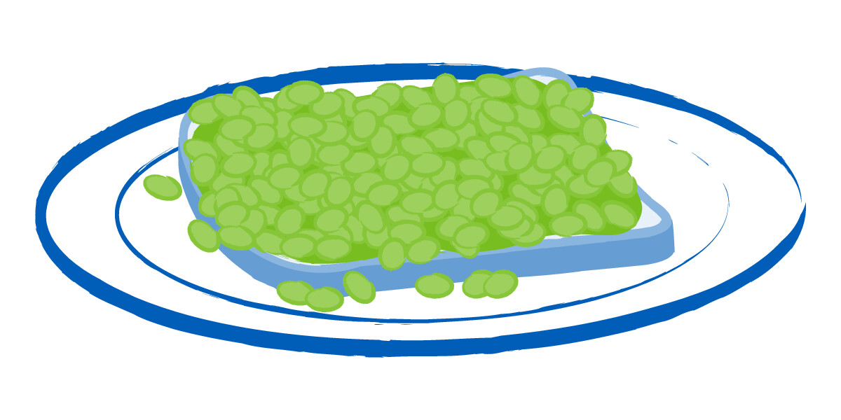
Scenario 1
He liked to look smart
Clue –
a discarded sandwich
This is Sudesh (former bank manager)
One day when his wife was out he
cut a hole in the sleeve of his jacket

Slide 9
Breaking it down
‘’Oh no, I look a mess!”
“I need to get rid of this stain!”
Cut the stain out of his jacket!
Embarrassed,
Anxious,
Shame
Need -“I must look smart and presentable”

Slide 10
Scenario 2
Mark and Susan
Mark’s Garden
Mark becomes angry when Susan intervenes…
Mark has been muddling up lawn feed and weed killer

Slide 11
“She’s been interfering in my domain!”
Breaking it down
Put fists up to Susan
Angry, confused
Need – to be in control, capable and independent
“I know what I am doing”

Slide 12
Scenario 3
This is Joyce
Intruders broke into her bungalow
She started dragging furniture up against the door of her room
Her family moved her into a local care home

Slide 13
Breaking it down
“They will get in when I’m sleep”
“They will hurt met”
Puts furniture against the door
Scared, afraid, anxious
Need – to feel safe
“I must stop them coming into my room”

Slide 14
Further reading
Alzheimer’s society factsheets:
www.alzheimers.org.uk/get-support/publications-factsheets-full-list
The brain and dementia
Changes in behaviour
Aggression and dementia
Walking about (wandering)
Your relationships: How dementia might affect your relationships

Slide 15
Time for our next break
Any examples to share of a new behaviour related to a specific event that we could think about as a group?

