Slide 1

Berkshire Memory and Cognition Research Centre
Healthcare Research
Sarra Blackman

Slide 2
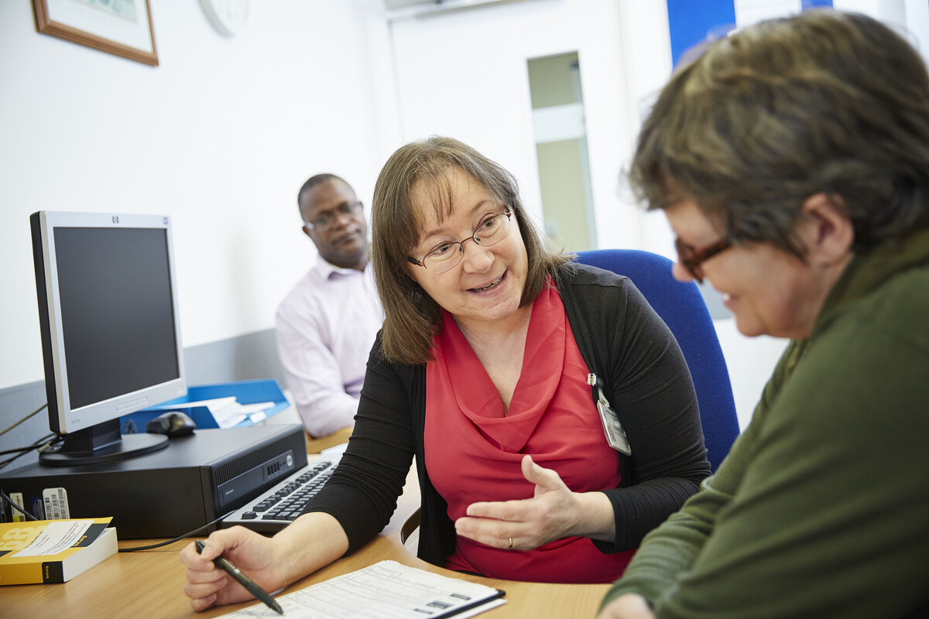
What does Research mean to you?

Slide 3


What does Research mean to you?

Slide 4
Where does research come from?
Academics… University staff and students
Commercial companies… Medicines and medical devices
NHS Staff… Consultants and Healthcare Professionals
All our healthcare research is regulated by the
National Institute of Health Research (NIHR) and
undergoes a rigorous ethical approval process.

Slide 5
Why take part?
We need to develop better treatments and improve health care services
Taking part in research can be a rewarding experience
Through research your voice can be heard
We will support you all of the way through the study process
Every year the clinical research network organise a satisfaction survey for participants.
For the year 2019/20:
96% of participants said that taking part was a good experience
87% said that they would take part again

Slide 6
What are your rights?
Research helps improve our understanding of conditions and helps us to improve treatments and services.
Although research active providers are shown to provide better care to patients this is regardless of participation.
Being a participant is always voluntary and participants are fully informed before agreeing
Asking to find out more about a study does not mean you have to take part
You always have the right to withdraw at any point and this will never affect your medical care or treatment
You will never be identifiable in the findings or reports written as a result of the research that you have taken part in

Slide 7
How to get involved
Ask our Memory Clinic team, or contact our Research Team directly if you’d like to know more
Add you name to our Research Interest List
Fill in a leaflet reply slip – this register remains confidential within Berkshire Healthcare NHS Foundation Trust
Register for ‘Join Dementia Research’
Complete a self-referral online (www.joindementiaresearch.nihr.ac.uk/) or paper copy
If you have interest in a specific study
You can ask to take part in specific studies you’re interested in, without joining the register.
You are never under any obligation.
You can opt out, decline or withdraw from any study at any time.

Slide 8
Thank you
questions…
The Berkshire Memory and Cognition Centre,
Harry Pitt Building, Earley Gate,
University of Reading,
RG6 7BE
Call 07342 058 725
Call 0118 378 5700
Email research@berkshire.nhs.uk

