Slide 1
Treatments for dementia
Treatments that don’t involve drugs
Drug treatments
Lifestyle changes / living well with dementia

Slide 2
Treatments that don’t involve drugs
Cognitive stimulation therapy (CST)
14 week group programme to help improve mental abilities by keeping the person’s brain active
Reminiscence therapy
Involves talking about a theme from the person’s past (often using prompts) – can help with mood as well as memory
Life story work
Using a scrapbook, album or app to records details of the person’s life (such as their experiences, values or beliefs)

Slide 3
Treatments that don’t involve drugs
Cognitive rehabilitation
This involves support to achieve an individual’s specific practical goals e.g. learning to use a mobile phone
Talking therapies such as counselling
These might help the person to come to terms with their diagnosis, or help with depression or anxiety
Not all of these will work for everyone.
It will depend on the individual, the type of dementia they have and the stage their dementia is at.

Slide 4
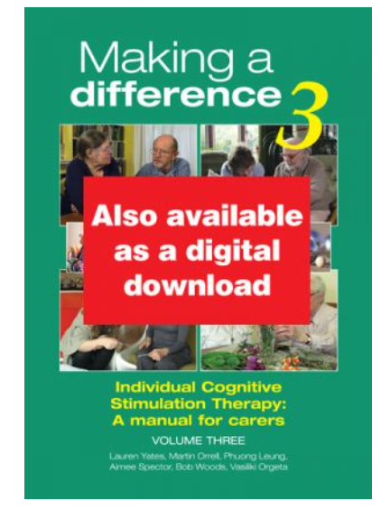
Individual Cognitive Stimulation Therapy: A manual for carers
Making a Difference 3
This third cognitive stimulation therapy (CST) manual is for carers who want to make a difference to the quality of life of the people with dementia they know or who they are living or working with.
It builds on the proven success and popularity of CST by offering 75 individual sessions on a great variety of topics to suit everybody’s tastes and interests.
Hawker Publications
ISBN 978-1-874790-29-7
Call 020 7720 2108

Slide 5
Drug Treatments (overview)
Drugs to prevent or reduce underlying risks of dementia
Drugs to delay how symptoms develop & progress over time
Drugs to alleviate symptoms or consequences of dementia

Slide 6
Drugs to prevent or reduce underlying risks of dementia
Important for all – but particularly if a Vascular dementia has been diagnosed
Aspirin
Blood pressure tablets
Cholesterol (statins)

Slide 7
Drugs – to delay how symptoms of disease develop
For Alzheimer’s disease and Dementia with Lewy Bodies
Donepezil / Rivastigmine / Galantamine
Memantine - generally for moderate stages but may be prescribed in early stage for those who cannot tolerate the first three drugs.
In others who are tolerating one of the above, Memantine may be considered as an add-on
The main aim of these drugs is to increase levels of the chemical neurotransmitter between remaining nerve cells
They are not a cure but may stabilise symptoms for a limited period of time, as well as helping with other concerns such as agitation and poor sleep
Around 60% gain some benefit.

Slide 8
Drugs to alleviate symptoms or consequences of dementia
Antidepressants
To treat agitation, irritability, low mood, anxiety, poor sleep, aggression
Sleeping tablets
To help with poor sleep or unusual sleep patterns
Antipsychotics
To treat hallucinations, delusions, aggression, severe behaviour problems.

Slide 9
Lifestyle changes
Try to encourage your relative to focus on the here and now and to remain as active as possible – routines and the use of memory aids can help to support this – aim to have something specific to do every day
Staying physically active helps both fitness and mood
Having a good diet
Staying socially active – try to support your relative in maintaining old friendships or in fostering new ones (groups / clubs will be covered later on course)

Slide 10
Lifestyle changes
Staying mentally active

Slide 11
If you notice increased confusion:
Sudden changes may not necessarily mean that the dementia is getting worse – they may be as a result of:
Minor infections
Holidays
Falls / accidents
Bereavement
Moving house
Unexplained

Slide 12
Prognosis – looking into the future
No simple answer – from 1 – 26 years!
Every person is different – every dementia journey is different.
Studies suggest the main factors to consider are:
Age of onset
General health when diagnosed
Which form of dementia they have
How much they can still do for themselves ‘functional’ ability seems to matter more than ‘cognitive’ ability. People who continue to try doing things for themselves, even if their dementia is quite advanced, tend to live longer than those who stop
Many people with dementia never reach ‘end-stage dementia’.

Slide 13
Thank you
questions…

