Slide 1
Understanding Dementia Course
What is dementia?
Dr. Jacqui Hussey, Consultant Psychiatrist

Slide 2
So…what is dementia?
Dementia is a general term used to describe a group of conditions which affect memory
People may find it harder to remember things and develop other problems with their thinking
These make it more difficult to cope with their day to day life
In dementia these problems get worse - or are 'progressive’.
They are not a normal part of ageing.

Slide 3
There are many different types
of dementia
Dementia commonly starts with memory problems, but a person with dementia can also find it hard to:
Plan and carry out day-to-day tasks
Communicate with others
Cope with changes in their mood, ability to make decisions, or you may see changes in their personality
Live independently - as dementia is 'progressive’, they will become more dependent on others to help them as time goes on

Slide 4
How common is dementia?
It currently affects more than 850,000 people in the UK
It becomes more common as we get older, so:
At the age of 65, about 2 in every 100 people will have dementia
By the age of 85, about 1 person in every 5 will have some degree of dementia
Dementia can sometimes affect younger people and can run in families, although this is less common.

Slide 5
Is it normal ageing or dementia?
There is a ‘normal’ level of cognitive decline associated with ageing
Cognitive abilities peak at different ages
Processing speeds: age 19
Short-term memory: late 20’s
Understanding emotional states: late 40’s – 50’s
Dementia may be diagnosed if a person is scoring below
the normal range for their age on a number of cognitive screening tests

Slide 6
Many of us have
some experience of dementia…
24.5 million people in the UK, 38 per cent of the population, know a family member or friend with dementia.
Source: Alzheimer’s Society March 2016
But if you’ve met one person with dementia……..
You’ve met one person with dementia
Remember - the person you are caring for is not the same as someone else’s relative or friend, and their dementia may develop in a very different way.

Slide 7
Changing attitudes
to dementia
Today dementia is usually diagnosed early
We can often provide successful interventions to support the person with dementia and their family, and sometimes treatments to slow the decline
Dementia often means having to make some lifestyle changes
That said - many people live well with dementia.

Slide 10
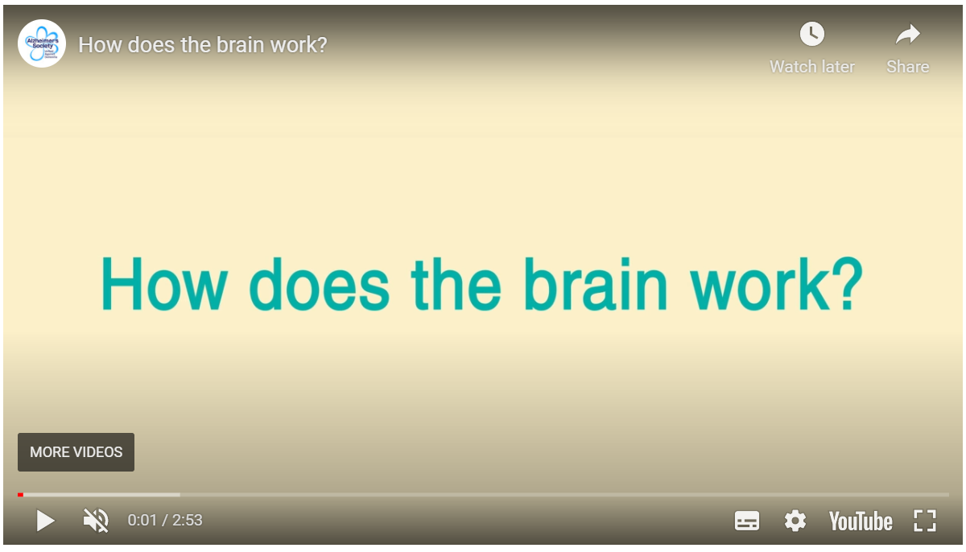
Alzheimer’s society Brain tour How does the brain work?
Alzheimer’s Society have created a video called How does the brain work?
3 ways you can watch the video
Search for ‘How does the brain work?’ on YouTube, or
Follow this link on your internet browser: youtu.be/lUYT8sZ4l18, or
Go to the next slide, and click the middle button

Slide 12
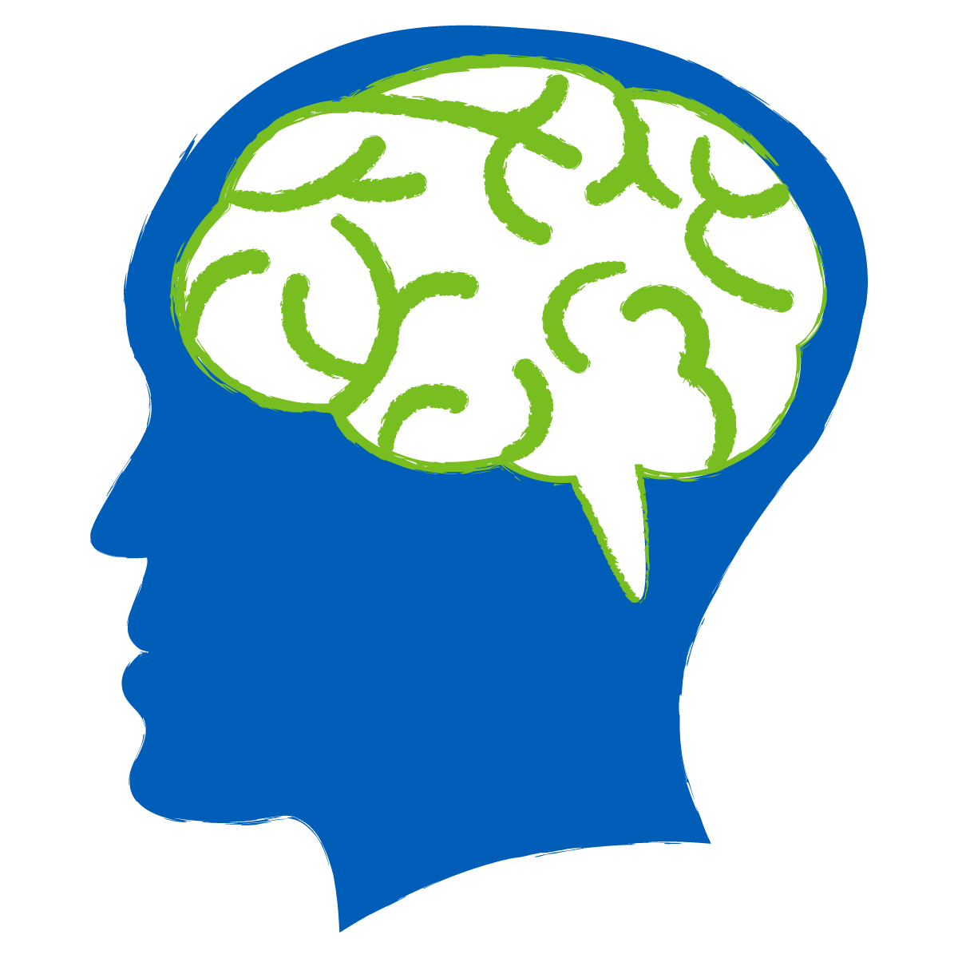
Front lobes
Decision-making
Problem solving Planning, Behaviour
Parietal lobes
Sensory information
Space
Size
Movement
Temporal lobes
Memory
Hearing
Language
Occipital lobes
Visual information

Slide 13
Alzheimer’s Dementia 62%
Dementia
Dementia with Lewy Bodies
4%
Mixed Dementia Vascular/ Alzheimer’s
10%
Parkinson’s Disease
Dementia
2%
Other Dementias
3%
Fronto- Temporal Dementias 2%
Vascular Dementia
17%

Slide 14
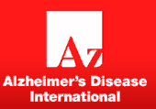
Source: Alzheimer’s Disease International

Slide 15
To diagnose, there must be a minimum of 2 of the following symptoms:
Memory problems / repetitive / losing things / forgetting events / getting lost
Problems in Reasoning & performing Complex Tasks managing finances / understanding safety risks / poor planning & decision-making
Impaired Visuospatial abilities - in recognising faces & objects / finding objects in clear view / putting clothes on the right way
Impaired Language functions - finding words / reading / spelling
Changes in Personality & Behaviour uncharacteristic mood changes / agitated / apathetic / compulsive / unconcerned about others.

Slide 16
…and dementia is only diagnosed
when these symptoms:
Interfere with the person’s ability to function at work or in their usual activities
represent a change i.e. a decline from how that person was before
are not explained by a temporary illness causing a delirium
are not explained by a psychiatric illness such as depression

Slide 17
Who is at risk from dementia?
Any of us can develop a dementia but it is not a natural or inevitable consequence of ageing. Some medical conditions can make it more likely.. These include:
Parkinson’s disease
Strokes and heart disease
High blood pressure and high cholesterol levels
Type 2 diabetes mellitus
It is important to try to treat and manage these risk factors, particularly high blood pressure and diabetes.
It may also help, in the mid-life years, to manage any problems with hearing loss, obesity, social isolation and depression

Slide 18
Lifestyle factors that can increase risk of various types of dementia
Smoking
Drinking more than the safe limit of alcohol - more than 14 units per week
Lack of physical activity
Poor diet and being overweight
Repeated head injuries, e.g. in boxers
The World Health Organisation recommends that stopping smoking, reducing alcohol intake, increasing exercise and a healthy, balanced diet (e.g. the Mediterranean-like diet is specifically recommended) can reduce the risk of dementia, especially if these changes are made in your 40s and 50s.

Slide 19
Is dementia inherited?
Dementia can be inherited, but usually isn’t.
Most people who get dementia don’t have a family history – plus there’s a big difference between inheriting a gene which may slightly increase your chance of getting dementia (which can happen), and inheriting a gene which will definitely cause dementia (which is rare)

Slide 20
Genetics and Alzheimer’s disease
One copy of APOE4
Around
1 in 4
people
3X
more likely to get AD
Two copies of APOE4
Around
1 in 50 people
10X
more likely to get AD
APOE4
Apolipoprotein E

Slide 21
Genetics and dementia
Genes are involved in some rarer types of dementia and research in this area is growing all the time:
A rare form of young-onset dementia called familial Alzheimer’s disease can be passed on (only 1% of AD)
Around 20-50% of people with frontotemporal dementia have inherited it from a close family member

Slide 22
Genetics and dementia
Try not to worry if someone in your family has dementia. Even if there is a family link, it’s far more likely that you have inherited a ‘risk gene’ rather than one which will definitely cause dementia.

Slide 23
Break
Questions and discussion

