Slide 1
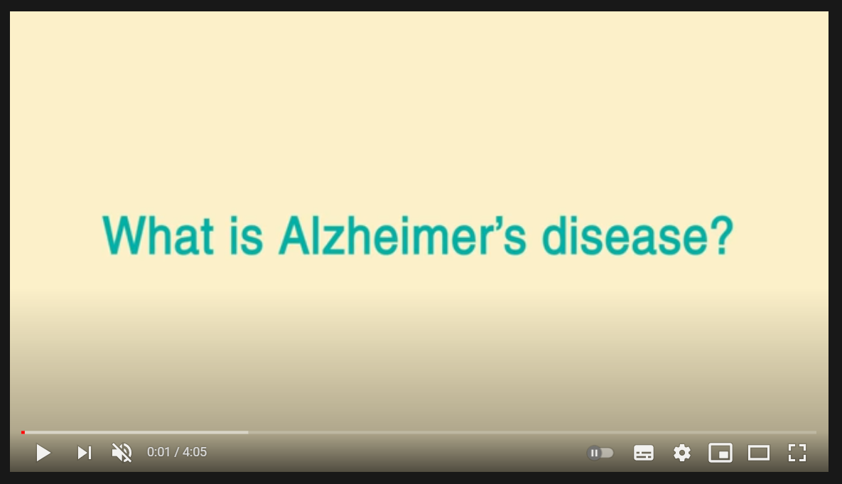


Alzheimer’s Society video clip:
What is Alzheimer’s disease?
Alzheimer’s Society have created a video called What is Alzheimer’s Disease?
3 ways you can watch the video
Search for ‘What is Alzheimer’s Disease?’ on YouTube, or
Follow this link on your internet browser: youtu.be/wfLP8fFrOp0, or
Go to the next slide, and click the middle button

Slide 2
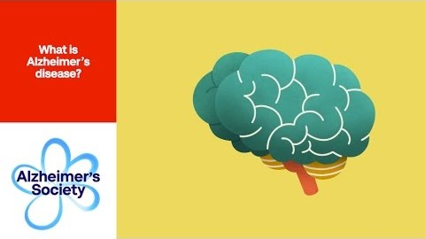

Slide 3
Alzheimer’s Disease
First described in 1907 by Alois Alzheimer, there is still a lot to be learned about the disease.
In Alzheimer's, proteins called amyloid and tau build up in the brain to form deposits called 'plaques' and 'tangles’
Damage happens to the brain in these areas, and this affects the chemicals in the brain which transmit messages from one cell to another, particularly one called acetylcholine
The plaques are usually first seen in the area of the brain that makes new memories
In Alzheimer’s there is usually a gradual decline in function which doesn’t fluctuate from day to day.

Slide 4
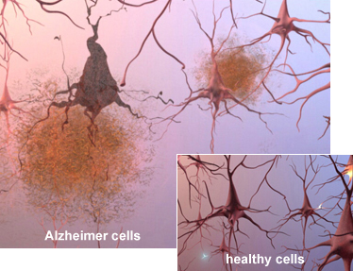
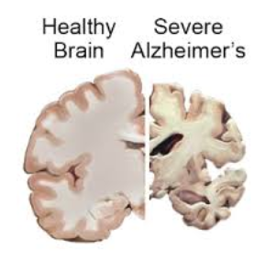

Slide 5
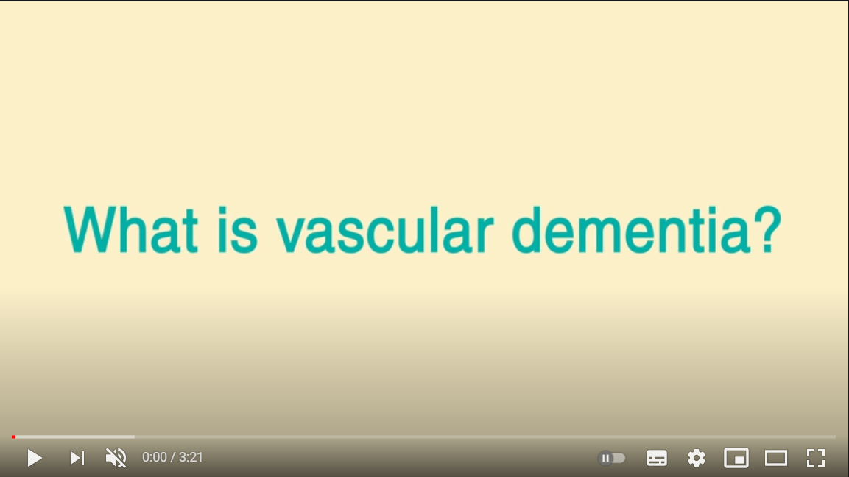
Alzheimer’s Society video clip:
What is Vascular dementia?
Alzheimer’s Society have created a video called What is Vascular Dementia?
3 ways you can watch the video
Search for ‘What is Vascular Dementia?’ on YouTube, or
Follow this link on your internet browser: youtu.be/GdkU5vCIpaU, or
Go to the next slide, and click the middle button

Slide 6


Slide 7
Vascular Dementia
Vascular dementia is caused by a reduced blood supply to the brain, due to damaged blood vessels.
This means that parts of the brain do not get enough oxygen and nutrients, and so brain cells die.
It is difficult to predict how a vascular dementia will progress, as the problems depend on which part of the brain is affected.
Symptoms
Memory loss and difficulty concentrating
Language difficulties
Mood swings or depression
Physical problems such as difficulty with walking, or incontinence
Fluctuation in ability to cope from one day to the next

Slide 8
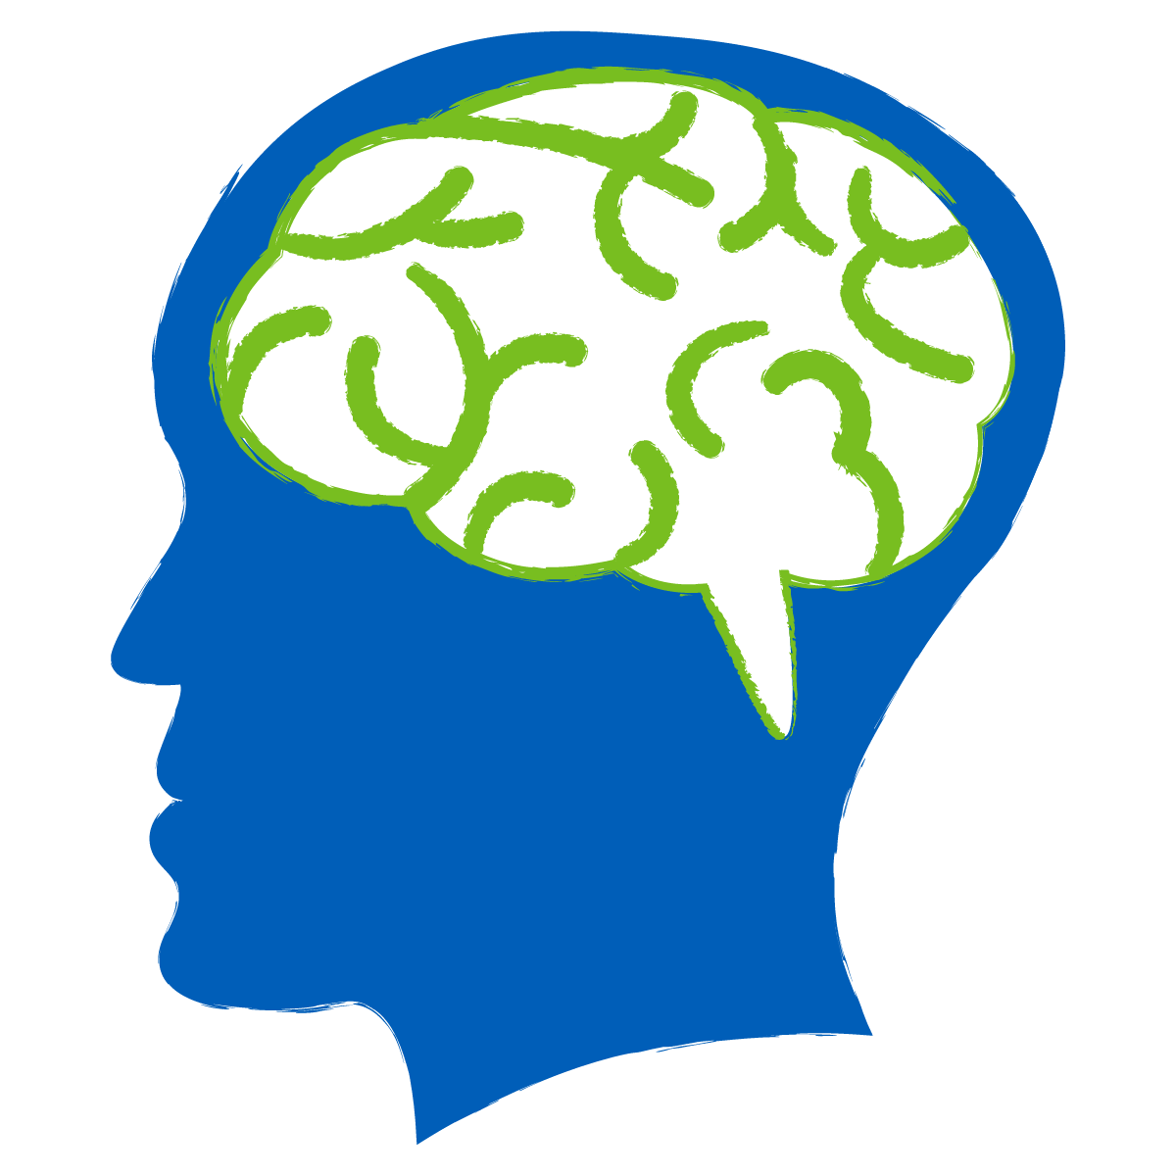
Vascular Dementia
Vascular dementia may be due to a
stroke or ‘mini strokes’ (TIA’s),
or to gradual damage to the small blood vessels
in the brain (‘small vessel disease’)
You are more likely to develop a vascular dementia if you have one of the conditions which can lead to blocked arteries - these include high blood pressure, diabetes, high cholesterol – and smoking.

Slide 9
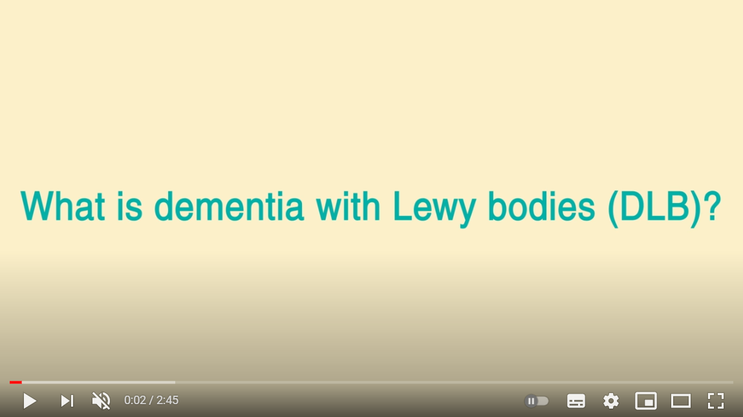
Alzheimer’s Society video clip:
Dementia with Lewy Bodies (DLB)
Alzheimer’s Society have created a video called What is Dementia with Lewy Bodies (DLB)?
3 ways you can watch the video
Search for ‘What is Dementia with Lewy Bodies (DLB)?’ on YouTube, or
Follow this link on your internet browser: youtu.be/hhE2dyeHP54, or
Go to the next slide, and click the middle button

Slide 10
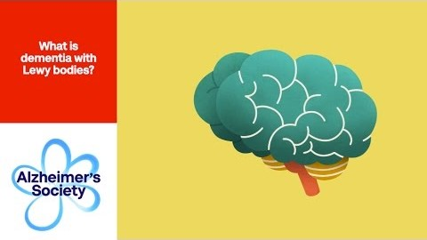

Slide 11
Dementia with Lewy bodies
An illness related to Parkinson’s but affecting more areas of the brain
Caused by the build-up of a protein (Lewy bodies) inside nerve cells in the brain (named after Dr Lewy who first observed them) in areas of the brain that control thinking, memory and movement
Symptoms of Lewy Body Dementia
Fluctuations in level of confusion, may change from hour to hour or day to day
Parkinson’s disease-type symptoms such as slowed movements, muscle stiffness and tremors
Visual hallucinations – often these can involve seeing people or animals that aren’t really there
Sleep disturbances which can cause people to move or talk in their sleep
Fainting, unsteadiness and falls

Slide 12
Parkinson’s Disease Dementia
Stooped posture
Tremor
Reduced facial expression
Slow movements
Fluctuating confusion
Visual hallucinations
1 year rule

Slide 13
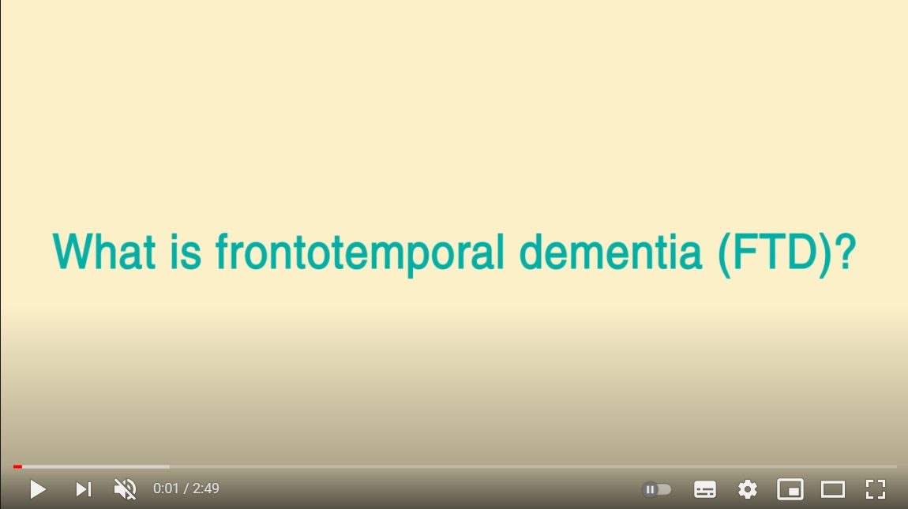
Alzheimer’s Society video clip:
What is Frontotemporal dementia (FTD)?
Alzheimer’s Society have created a video called What is frontotemporal dementia (FTD)?
3 ways you can watch the video
Search for ‘What is frontotemporal dementia (FTD)?’ on YouTube, or
Follow this link on your internet browser: youtu.be/QuJFLr5Ib9k, or
Go to the next slide, and click the middle button

Slide 14
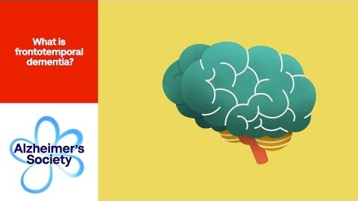

Slide 15
Frontotemporal dementia
This type of dementia mainly occurs in younger people, and often starts in people in their 50s and 60s.
Protein deposits build up in the frontal and temporal lobes.
Memory can be unaffected initially.
3 main types of Frontotemporal Dementia
Behavioural – a person who is usually very polite and proper might start to become irritable or rude, or may lose interest in looking after their appearance
Semantic – the main sign is in problems with understanding of language and memory for facts
Progressive non-fluent aphasia –early and prominent difficulty with speech and getting words out

Slide 16
Limbic-predominant age-related TDP-43 encephalopathy (LATE)
A new dementia has recently been identified by looking at post-mortem samples of brain tissue.
This is also common in older people and found along with the other disorders mentioned before.
It is not yet known how to diagnose LATE.

Slide 17
Rarer Causes
There are many other different types or causes of dementia.
Some can include:
Corticobasal Degeneration
Creutzfeldt-Jakob Disease
HIV-related cognitive impairment
Huntington's Disease
Multiple Sclerosis
Korsakoff’s Syndrome
Normal Pressure Hydrocephalus
Posterior Cortical Atrophy
Progressive Supranuclear Palsy

Slide 18
Reaching a Diagnosis
  The information gathered during Memory Clinic interviews
  (history / tests & investigations / ability to cope day to day)
  is weighed up and…a probable diagnosis is reached
  Should we tell the patient
  their diagnosis?

Slide 19
Break
Questions and discussion

