Slide 1

You & Your Baby:
Antenatal Presentation
Brought to you by your
Health Visiting Team

Slide 2
Content
Who are we and what do we do?
Building a happy baby
What to expect!
Keeping your baby safe
Parental wellbeing
Feeding your baby

Slide 3


Who are we and what do we do?
Health Visitors are trained nurses and/or midwives with additional training to work with families with children aged 0-5 years.
We aim to support you to be the best parent that you can for your child.
We work with staff nurses and nursery nurses to provide your local Healthy Child Programme.
We offer different levels of service for families with greater needs.
We work with other health and Early Years professionals to ensure the best outcomes for your child.

Slide 4
Your local Healthy Child Programme
Health visiting contact activity
Antenatal contact
New birth visit
6-8 week postnatal health review
9-12 month health review
2-2.5 year health review
Transfer in contact
Child health clinic
ChatHealth parent support line
Additional support

Slide 5
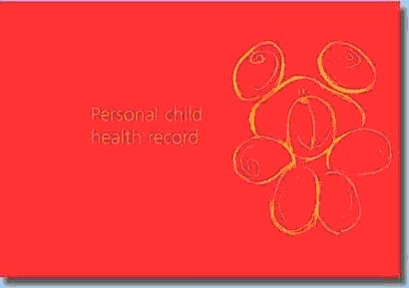
Your Personal Child Health Record
(Red Book)

Slide 6
Building a
Happy Baby

Slide 7
Brain development
Nature (genes) and nurture (how a baby is looked after physically and emotionally) work together in developing the baby’s brain.
The connections developing in your baby’s brain (which store information) are influenced by the information received from the care that your baby receives and from their environment.
Hormones also affect brain development. Babies release Oxytocin when they feel happy and safe. This has a positive effect on brain development and a child’s confidence and happiness.

Slide 8

Connecting with your baby before birth
Your baby will be able to hear you and recognise your voice
They will respond to music and may even startle with loud sounds
You and your family can be involved in speaking, singing or reading to your baby
Respond to their movements
Spend time thinking about what your baby may look like
Try to avoid highly stressful situations or being stressed for long periods of time

Slide 9



Helping your baby feel happy and safe
New babies need to be close to their parents. Skin to skin is a great way of building a bond and helping baby to feel secure.
When babies feels secure they release Oxytocin. This helps promote brain development and helps baby to feel comforted and happy.
Keeping baby close enables parents to recognise signals such as the need to be fed or comforted. You cannot spoil your baby by giving them this attention.
When babies’ needs for love and comfort are met they will be calmer and grow up to be healthy, secure children and adults.
Babies feel comforted and secure just by looking into their parent’s eyes.

Slide 10
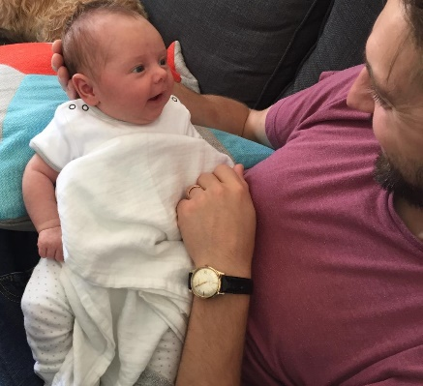


Helping your baby’s early development
1-4 weeks
Babies enjoy looking at familiar faces and hearing familiar voices.
Babies can respond to sights and sounds from an early age.
4-6 weeks
Enjoy smiling, talking to and listening to your baby and seeing their response.
4-12 weeks
Notice how your baby will try to lift their head while lying on their front.

Slide 11
Protecting Your
Baby

Slide 12
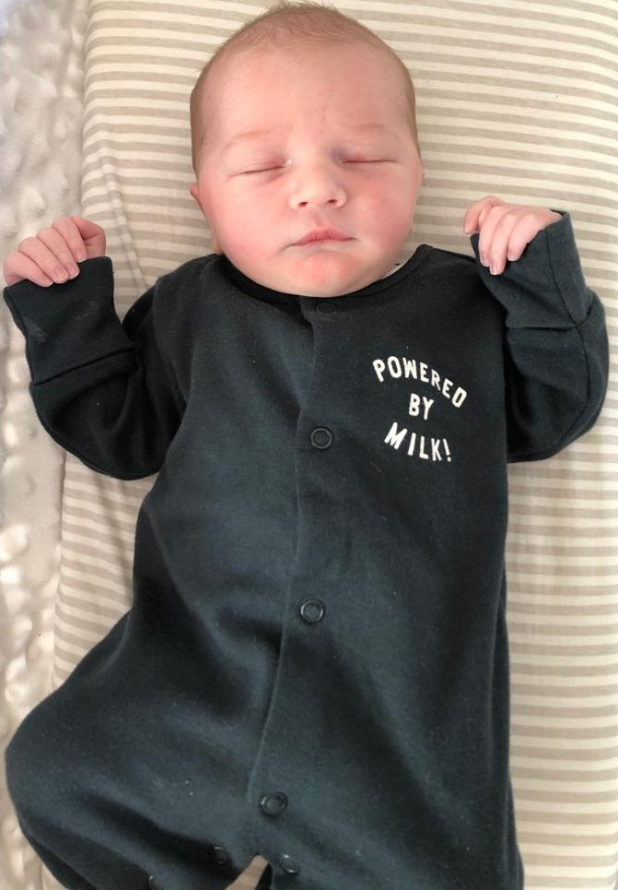
Sleeping like a baby…
New babies have a different ‘body clock’
Adults’ body clocks are based on release of hormones associated with sunlight and darkness.
New babies’ sleep is regulated by hunger.
New babies sleep 15-20 hours a day in bouts of 2-3 hours (breast milk takes 90 mins to digest).
Sleep is divided equally over day and night.

Slide 13

Safer sleep
A smoke free environment 24/7
A clear space
Temperature 16-20
A firm, flat mattress with no raised or cushioned areas
Feet at the bottom of the cot
Sleeping on their back
Image from the Lullaby Trust

Slide 14


Sleep - You and your baby
Film from the Lullaby Trust

Slide 15

Keeping your baby safe
Immunisations help to protect your baby against 17 diseases such as:
Whooping Cough
Septicaemia
Meningitis
Diphtheria
Tetanus
Polio
Rotavirus

Slide 16
Where should you get help
from if you are worried about your baby?
Your local pharmacist can help you with lots of everyday ailments and offer good advice.
Your GP can offer urgent appointments each day.
You can get advice and help fast from the 111 service. You can also obtain urgent out of hours GP services.
999 for serious accidents and emergencies.
Download the Lullaby Trust Baby Check app

Slide 17
Parental Wellbeing:
Looking after yourself

Slide 18



Emotional Wellbeing - Tips
Spend time with others
Eat healthy & stay hydrated
Get outdoors
Ask for advice from your
Health Visiting Team
Take breaks
Do things you enjoy
Exercise
Unwind
Be kind to yourself
07312 263 283
Ask for help

Slide 19




Emotional Wellbeing - Support
www.talkingtherapies.berkshirehealthcare.nhs.uk
0300 365 2000
You are NOT to blame!
There is support!
You can get better!

Slide 20
Feeding your
Baby

Slide 21
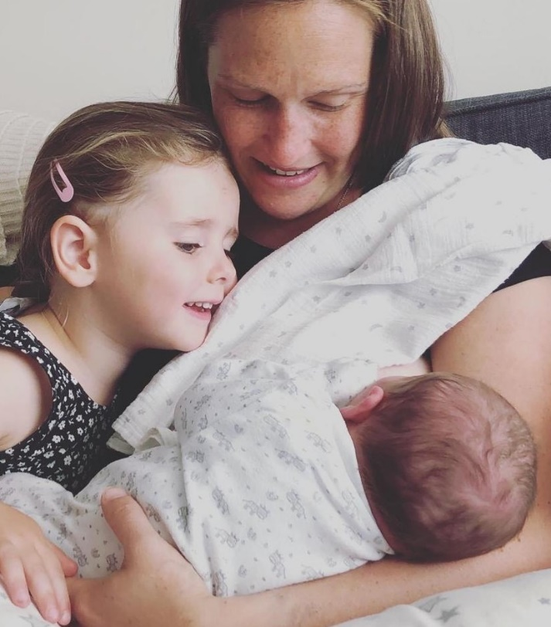
Responsive feeding – what is it?
Feeding when your baby when they show signs of being hungry: look out for cues (moving head and mouth around, sucking on fingers). Crying is the last sign of wanting to feed, so try and feed your baby before they cry.
Keeping baby close (day and night).
Follow baby’s cues for when they need a break.
Allow your baby to take as much or as little as they want.

Slide 22


Breastfeeding: What are the benefits?
Breastfeeding protects your baby against many
illnesses and infections
Breastfeeding prevents obesity & type 2 diabetes
in later life
Mothers who breastfeed have protection against
some cancers and other health conditions
Breastfeeding is free!

Slide 23

Feeding: What is needed?
Milk is all your baby needs for the first 6 months
You should let your baby cry or they will be spoilt
Breastfed Babies 0-6 months do NOT need water
Hungry baby/comfort formula can settle babies

Slide 24

Skin to skin
Holding your baby against your skin will calm your baby, steady their breathing and help to keep them warm.
This is a great time to start your first breastfeed because your baby is likely to be alert.
Keep your baby close to you and feed them whenever they are hungry, need comfort or when you want to. This will help your body to produce plenty of milk.
If you would like to know more, please visit the UNICEF UK website

Slide 25
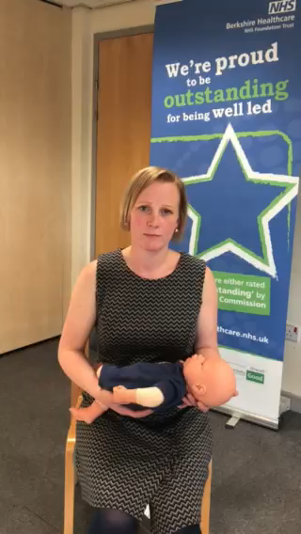

Positioning and Attachment
CHINS
C – Close
H – Head Free
I – In Line
N – Nose to Nipple
S – sustainable position
An effectively attached baby will:
Tilt their head back
Have a wide open mouth
Have the nipple to the back of the mouth by the soft palate
Have full rounded cheeks
Be content and satisfied
You will:
Hear and see baby swallowing
Be pain free!
To read more, visit:
Best Beginnings
CHINS was developed by
Dr Lynette Shotton, Northumbria University

Slide 26
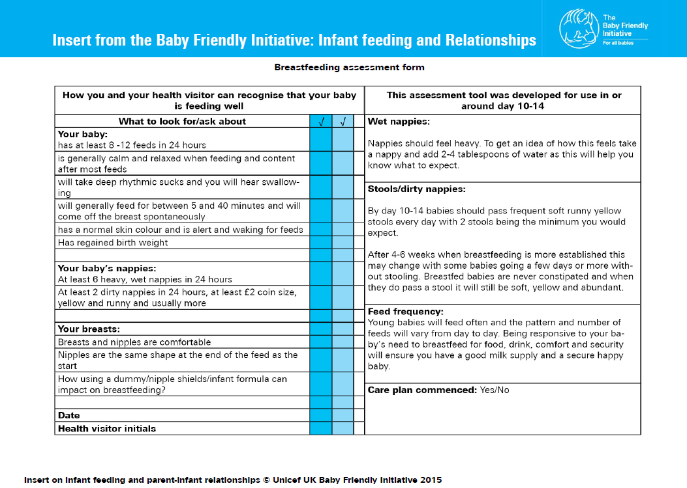

How do I know my baby is getting enough?
Take a look at the insert in your red book on infant feeding

Slide 27


Feeding: Vitamins
Breastfed babies up to a year 8.5 – 10 micrograms of Vitamin D a day.
Babies fed more than 500ml of infant formula a day should not be given additional vitamin D
Children 1-4 years and breastfeeding mothers should take 10 micrograms of Vitamin D a day

Slide 28





Feeding: Want more information?
nhs.uk/start4life
laleche.org.uk
unicef.org.uk
Firststepsnutrition.org

Slide 29

Contact Your
Health Visiting Team
Text
07312 263 283

Slide 30

Visit our website
cypf.berkshirehealthcare.nhs.uk

Slide 31
Feedback
We’d love to get your feedback on this presentation and find out how it has helped you.
Send us your feedback here
Thank you!

